Slide 1
AUTONOMIC NERVOUS SYSTEM (ANS)
DR OSO O.A

Slide 2
OUTLINE
Introduction
Anatomical components
Sympathetic Nervous System
Parasympathetic Nervous System
Enteric Nervous System
Conclusion/Summary

Slide 3
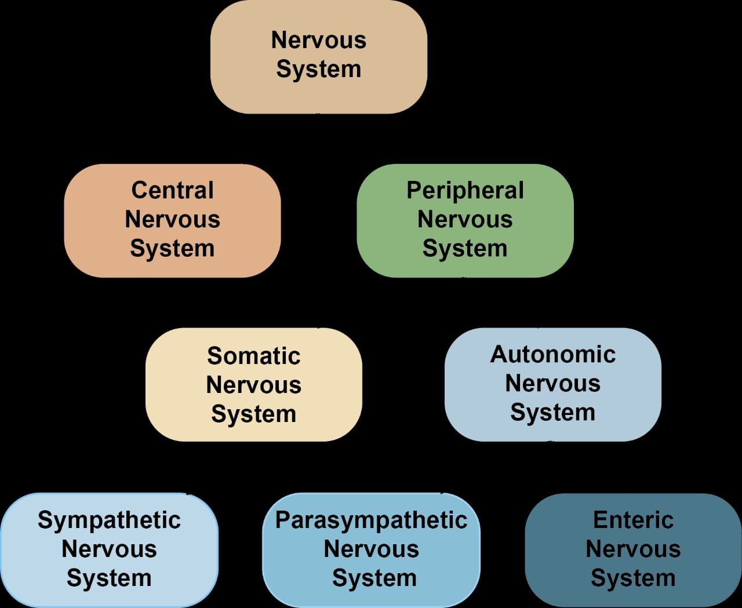
INTRODUCTION

Slide 4
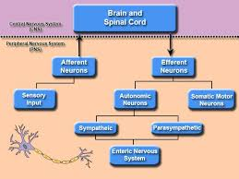
INTRODUCTION

Slide 5
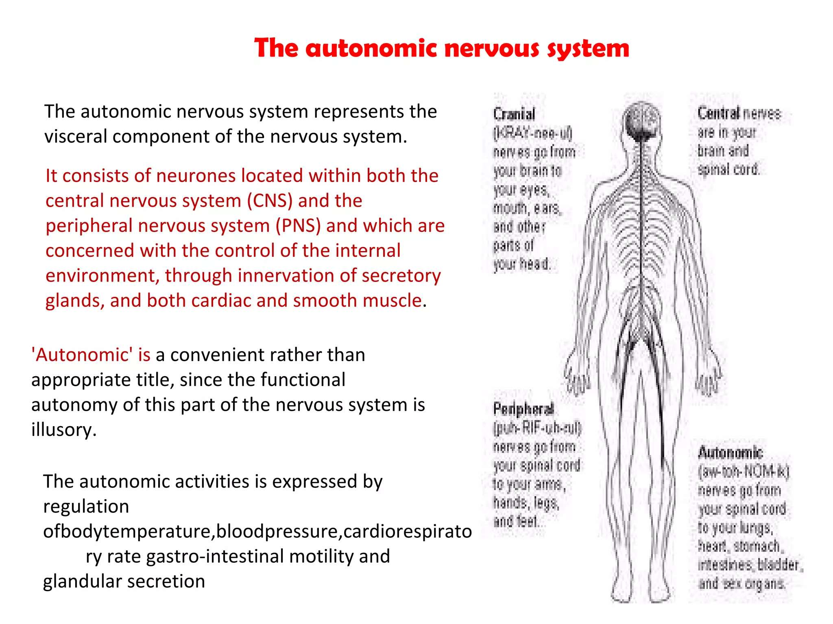

Slide 6
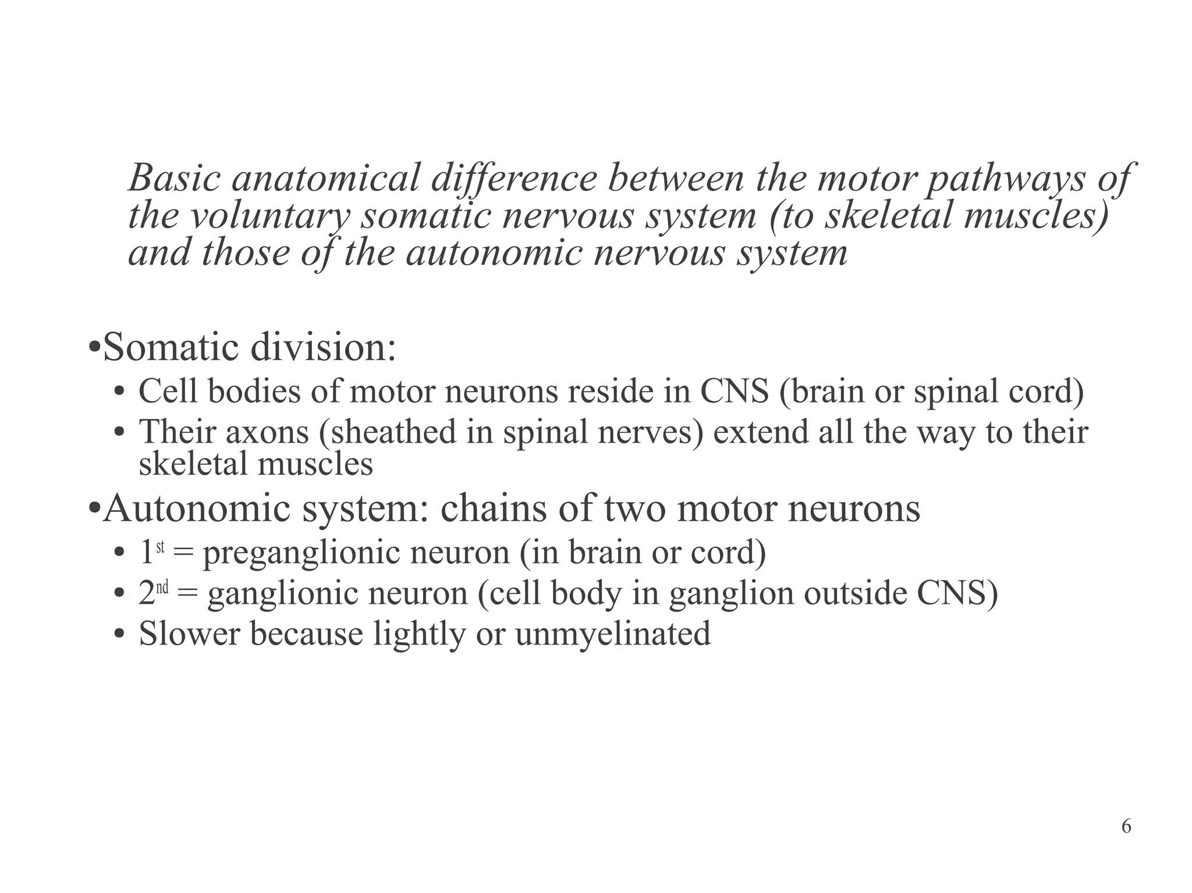

Slide 7
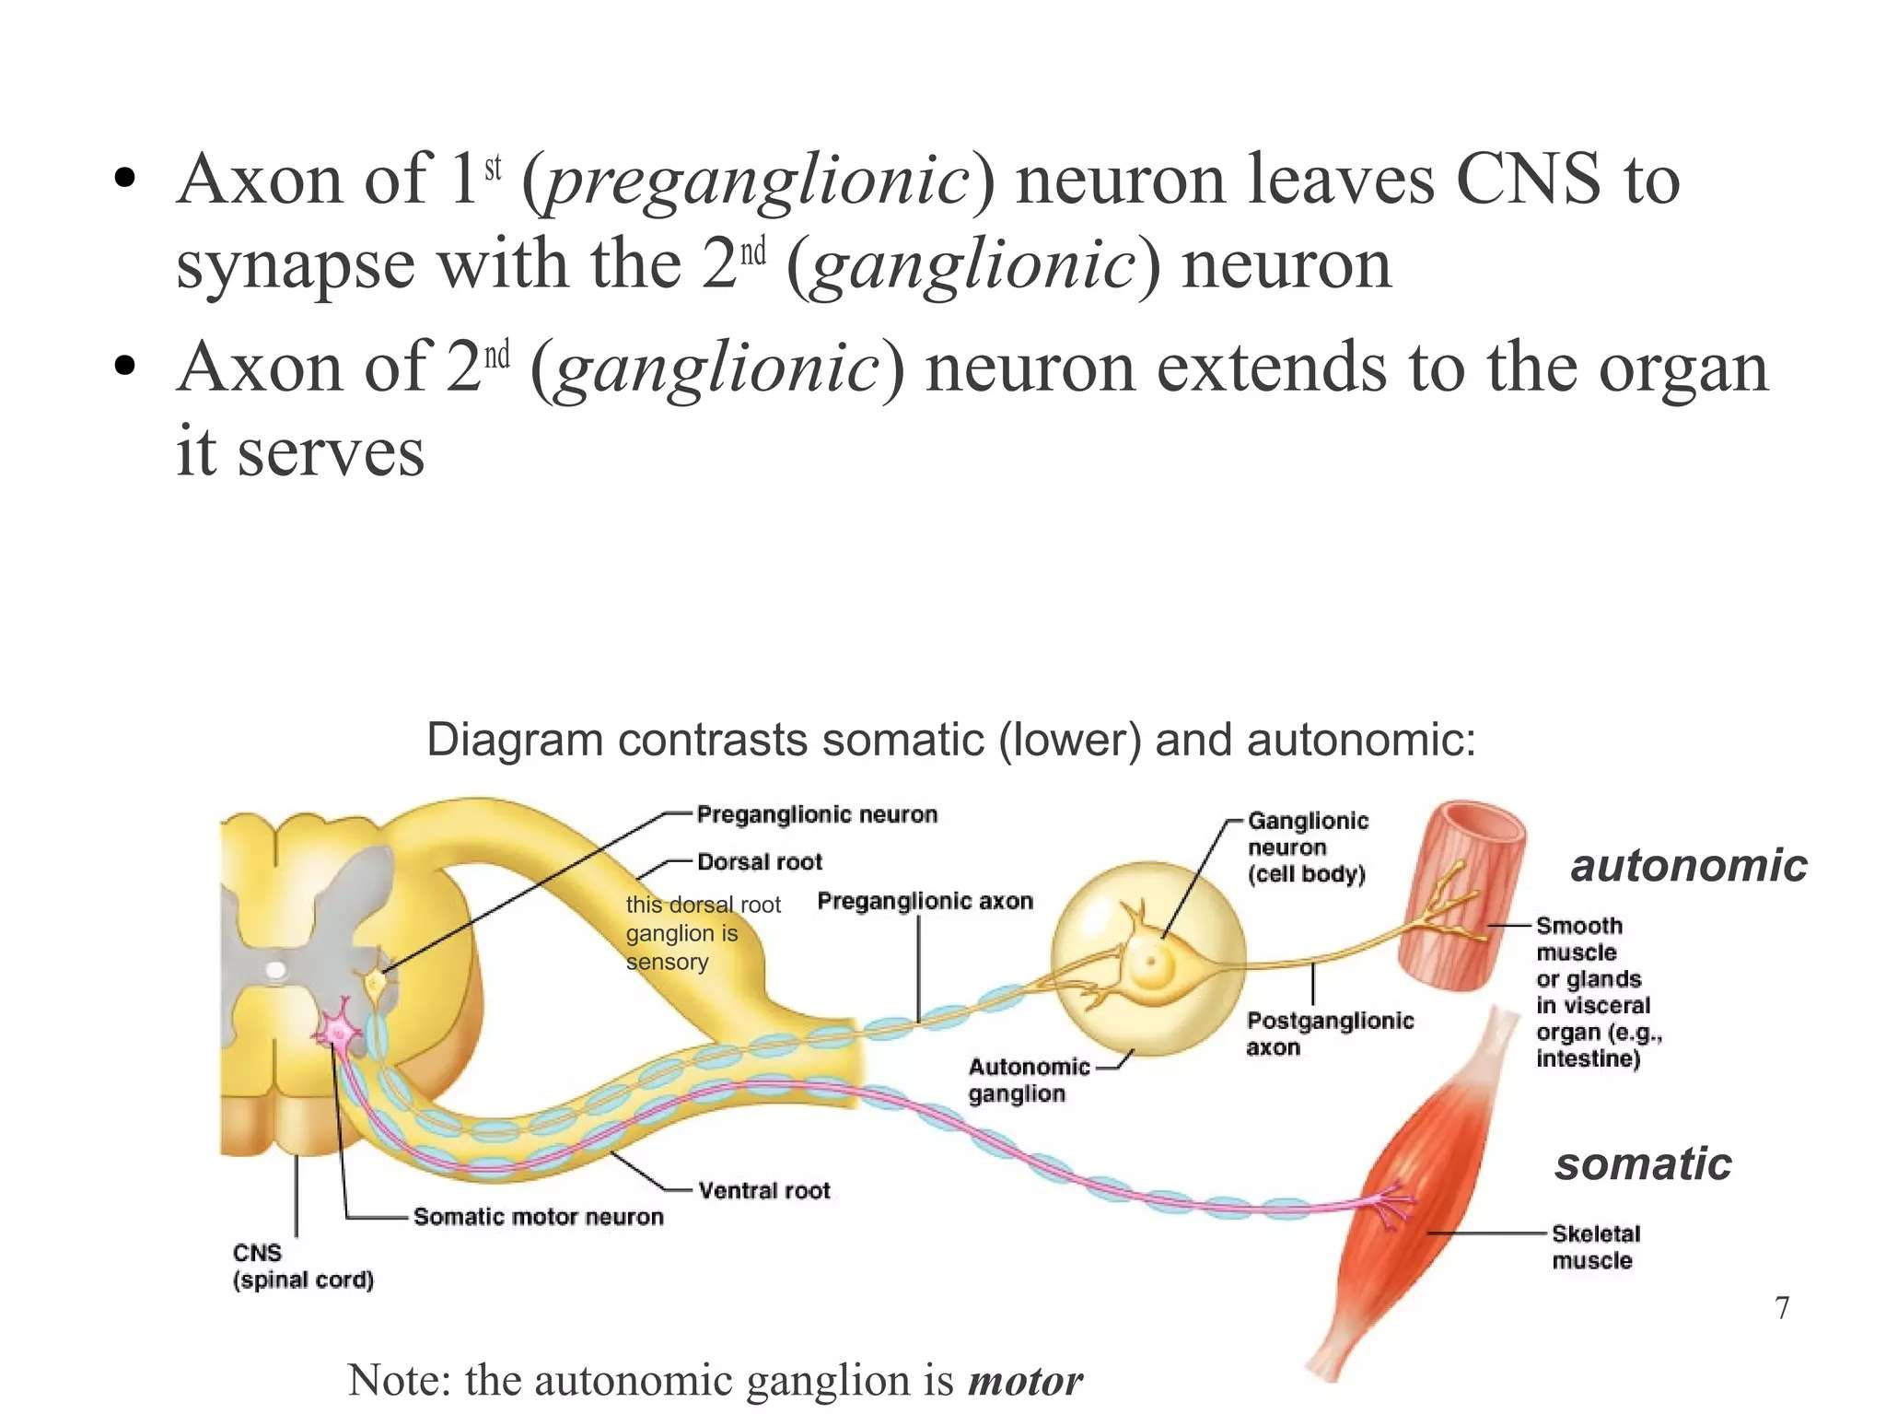

Slide 8
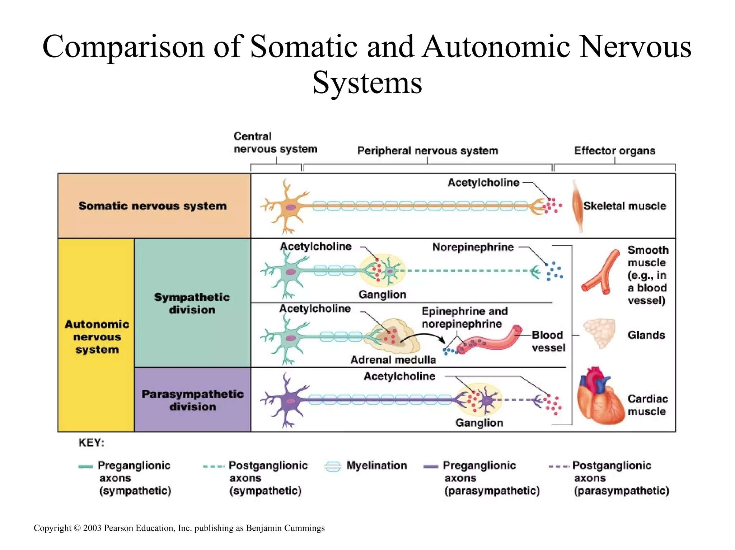

Slide 9
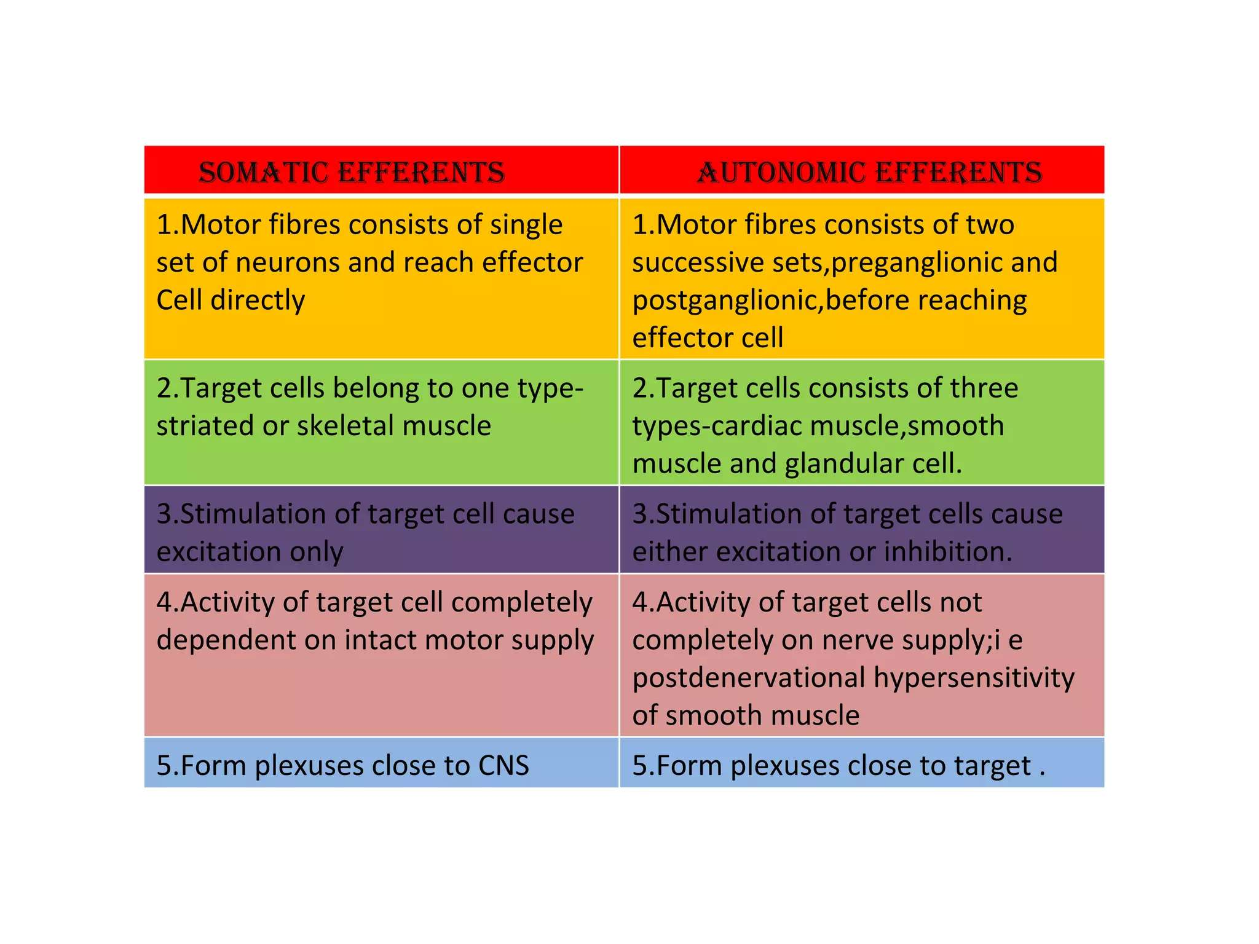

Slide 10
ANATOMICAL COMPONENTS OF ANS
Central Components (CNS)
Peripheral Components
- Preganglionic Fibers
- Autonomic Ganglia
- Postganglionic Fibers

Slide 11
Central Components (CNS)
• Hypothalamus – main control center
• Brainstem nuclei:
- Edinger–Westphal (CN III)
- Superior salivatory (CN VII)
- Inferior salivatory (CN IX)
- Dorsal motor nucleus of vagus (CN X)
• Spinal cord:
- Sympathetic (Intermediolateral cell column T1–L2)
- Parasympathetic (S2–S4)

Slide 12
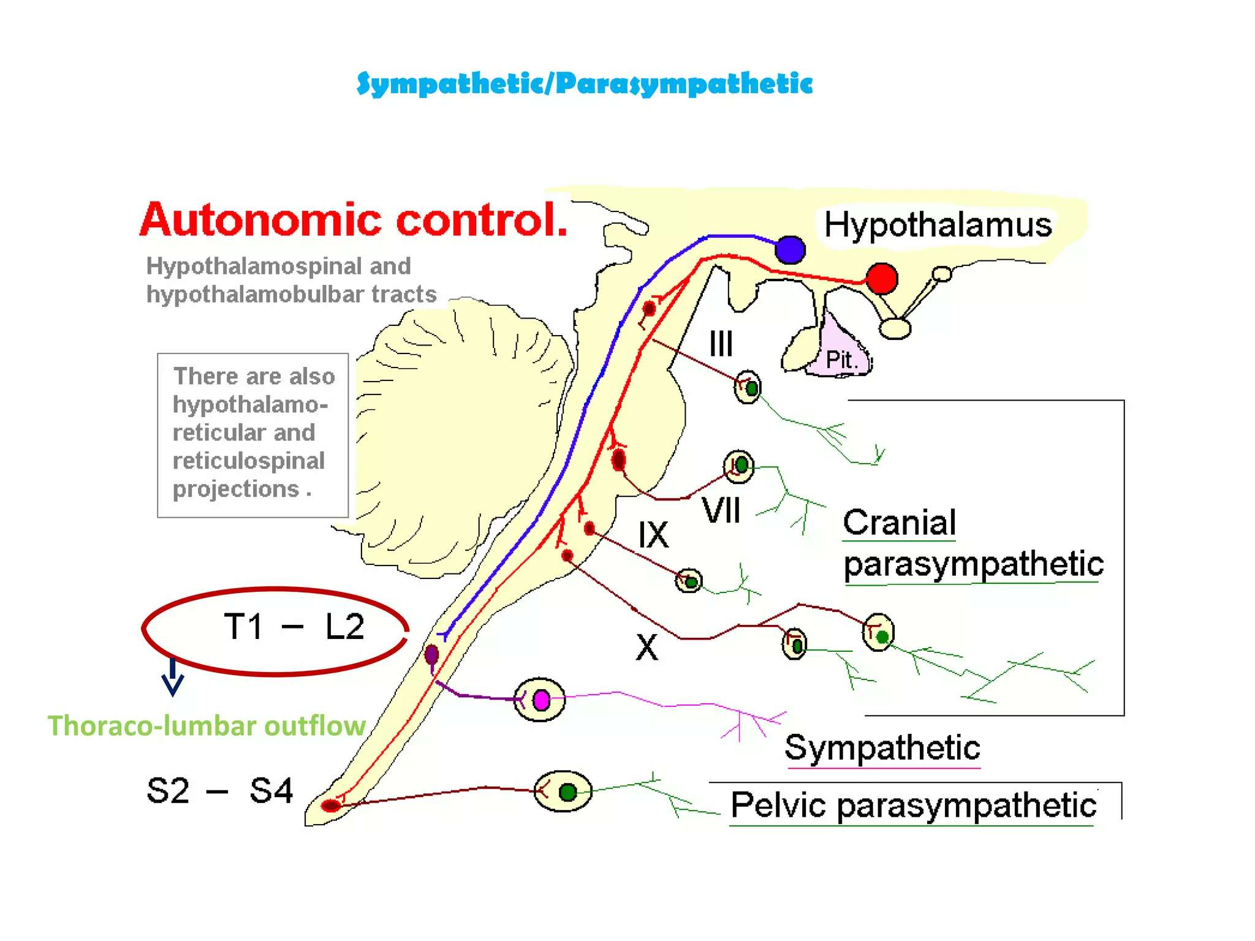

Slide 13
Peripheral Components – Preganglionic Fibres
Myelinated axons leaving the CNS
Originate from nuclei and synapse in autonomic ganglia

Slide 14
Autonomic Ganglia
Sympathetic (Thoracolumbar):
- Paravertebral ganglia (sympathetic trunk)
- Prevertebral ganglia (celiac, superior & inferior mesenteric)
Parasympathetic (Craniosacral):
- Cranial ganglia (ciliary, pterygopalatine, submandibular, otic)
- Terminal ganglia within or near target organs

Slide 15
Postganglionic Fibers
Unmyelinated axons leaving the ganglia to supply target organs

Slide 16
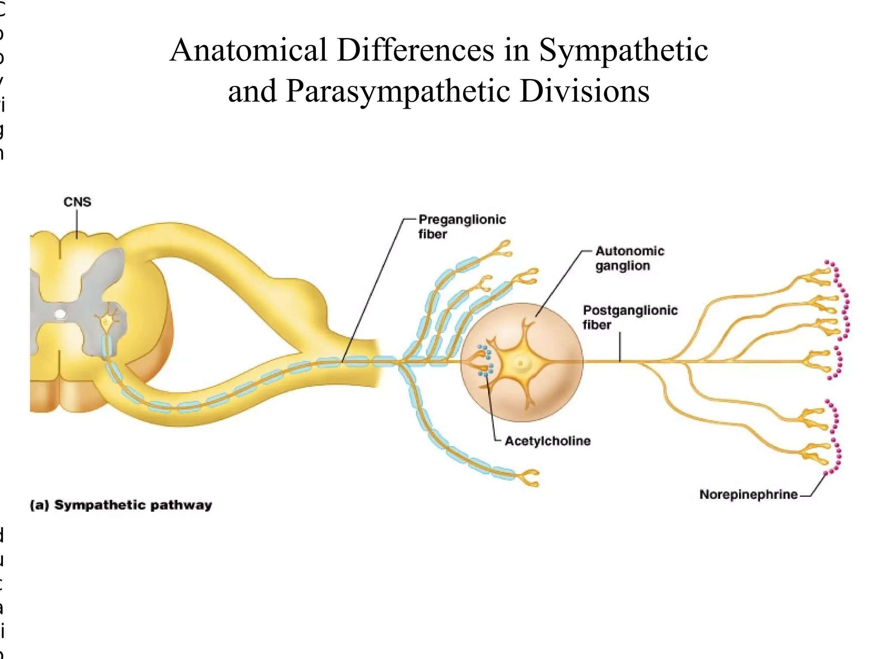

Slide 17
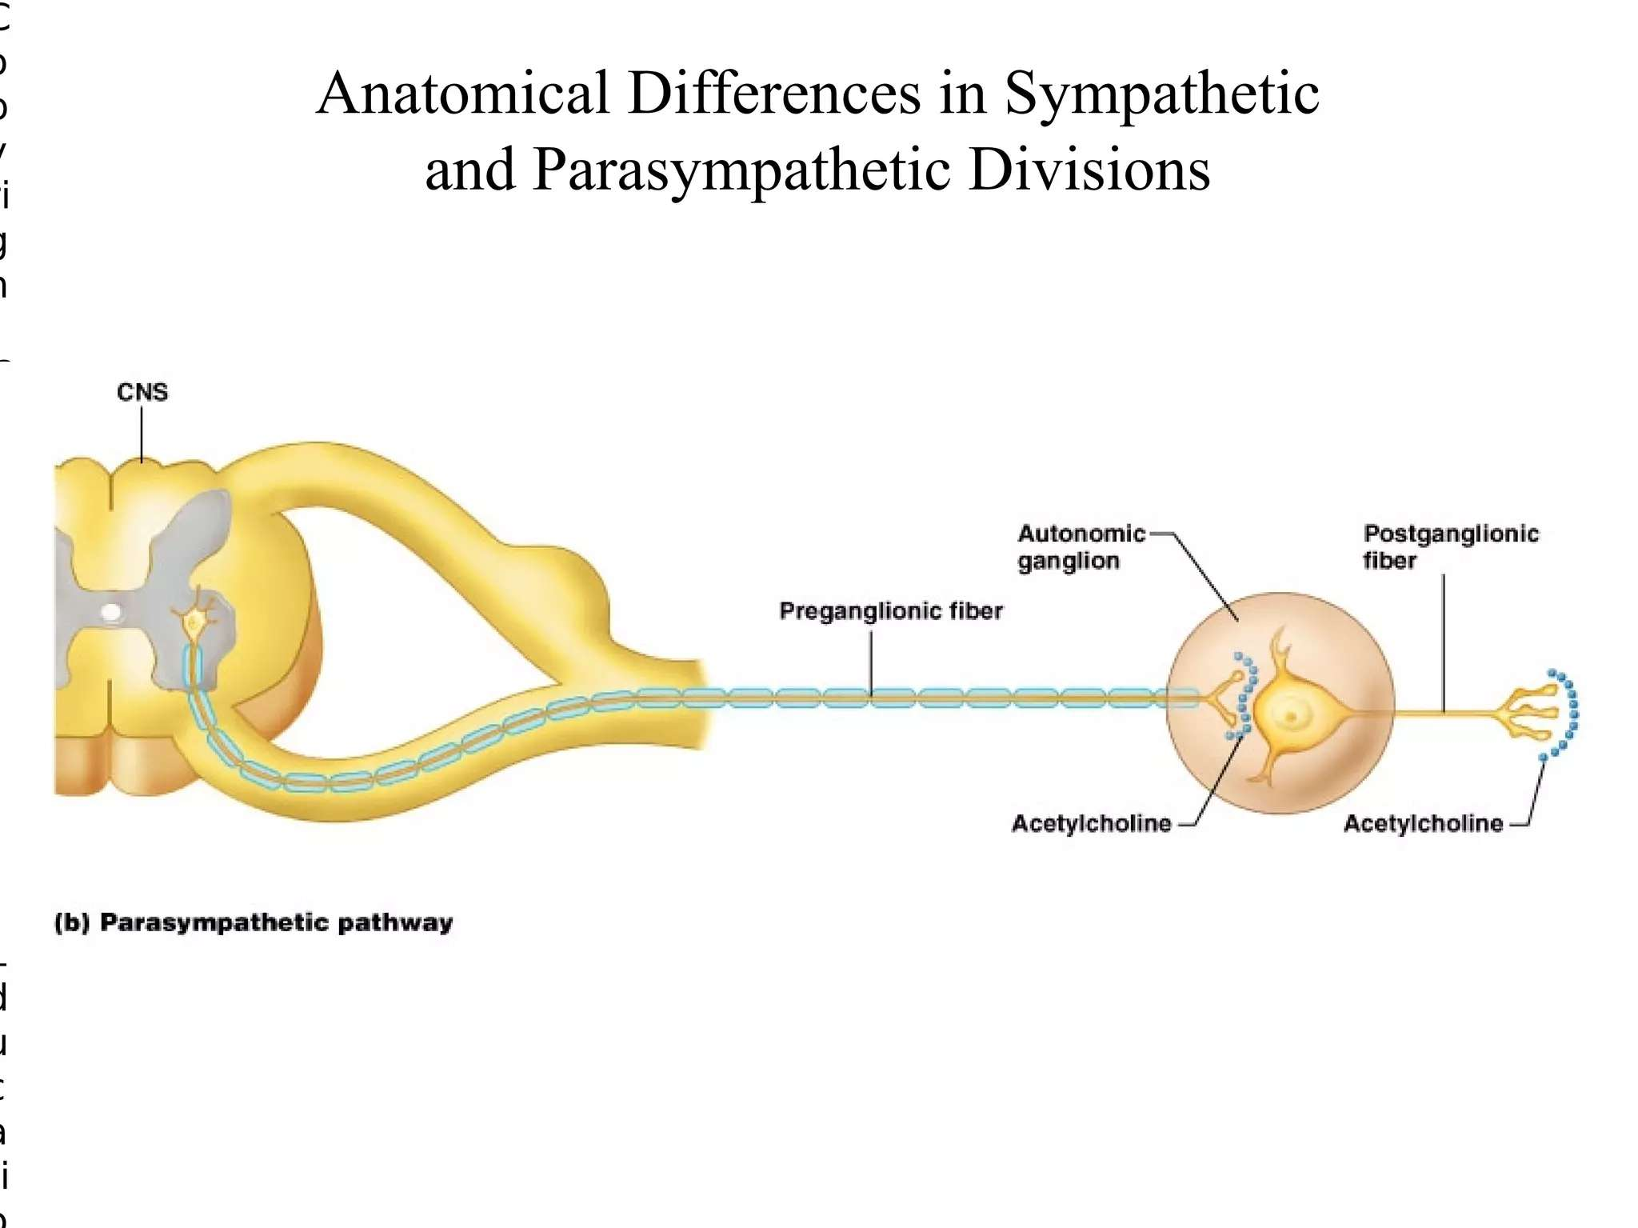

Slide 18
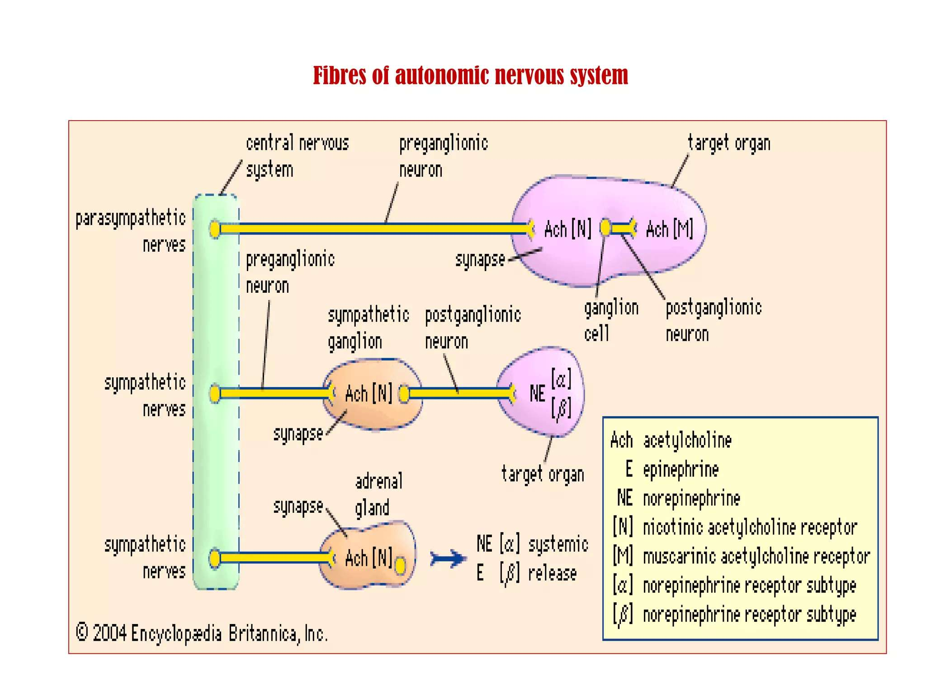

Slide 19
Sympathetic Nervous System

Slide 20
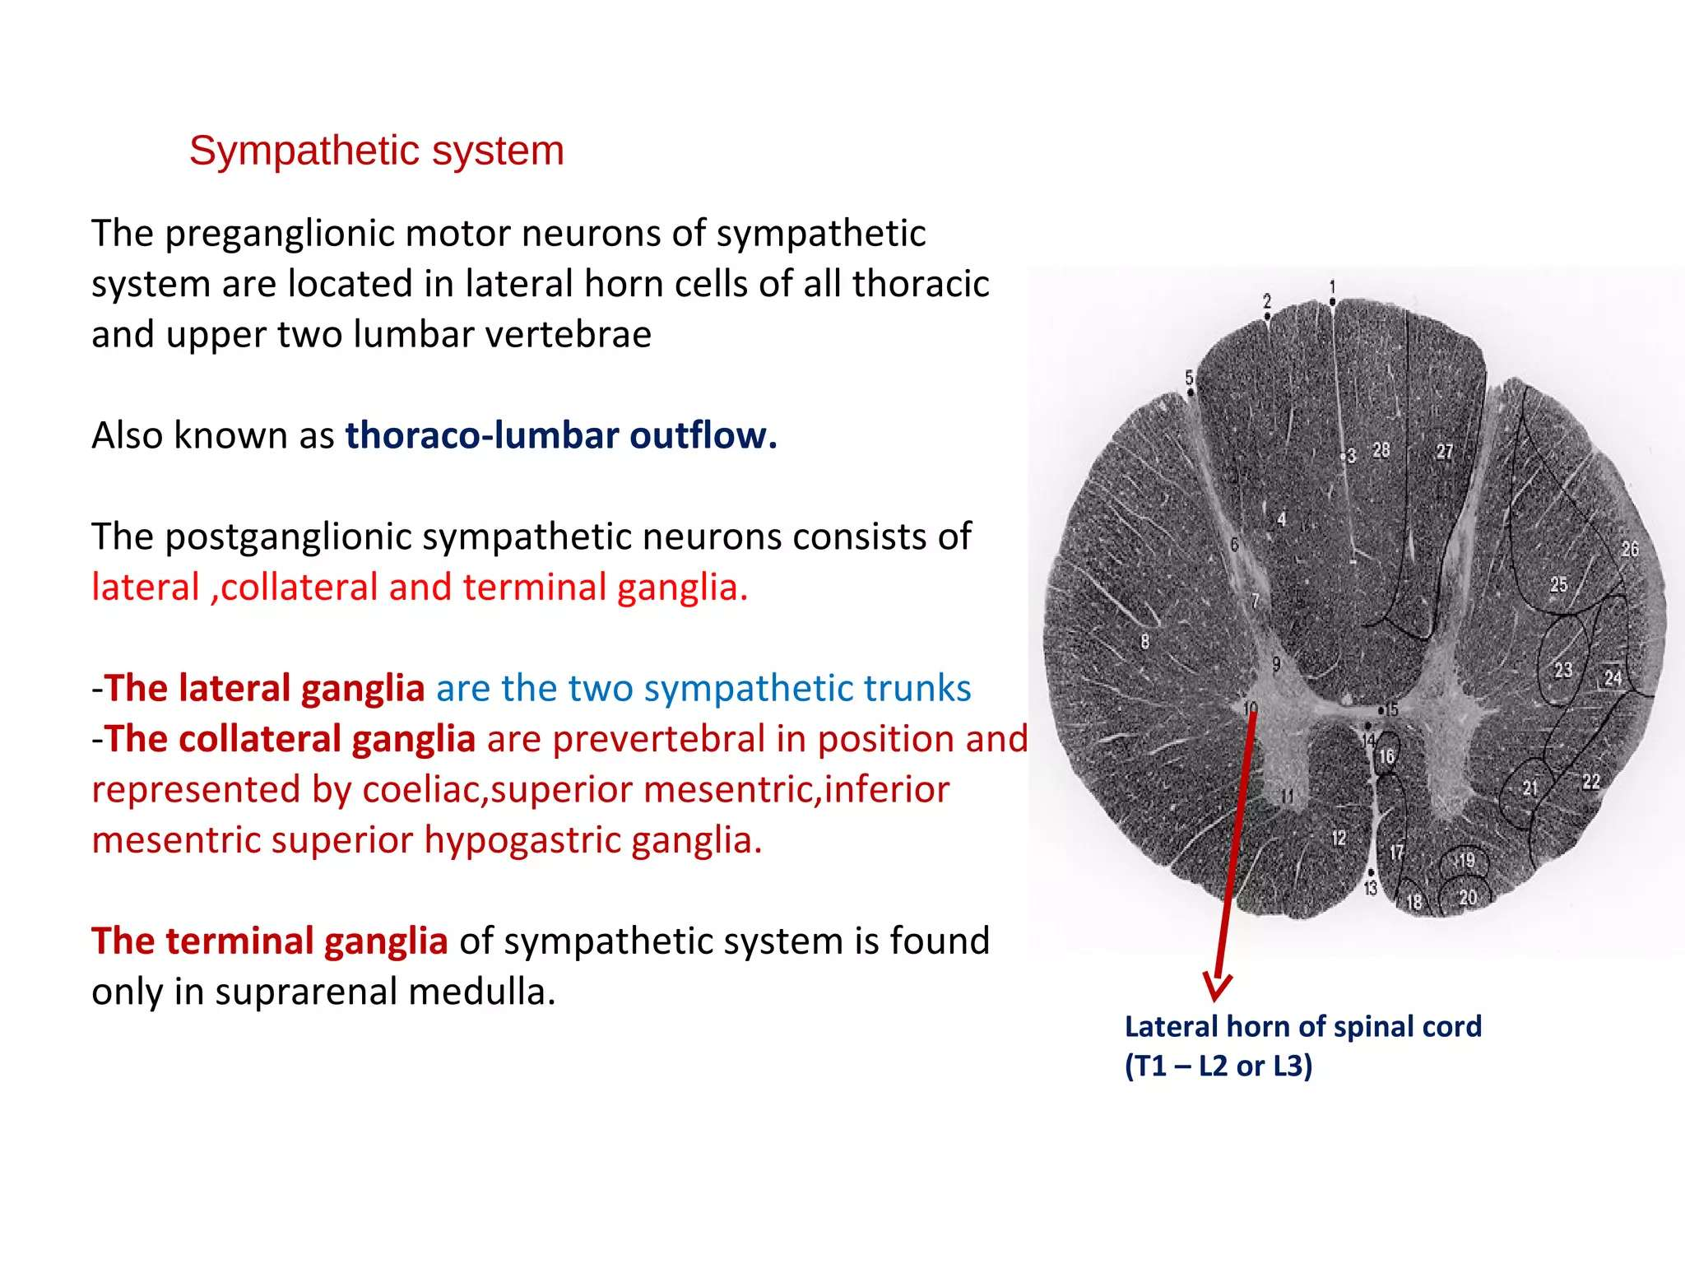

Slide 21
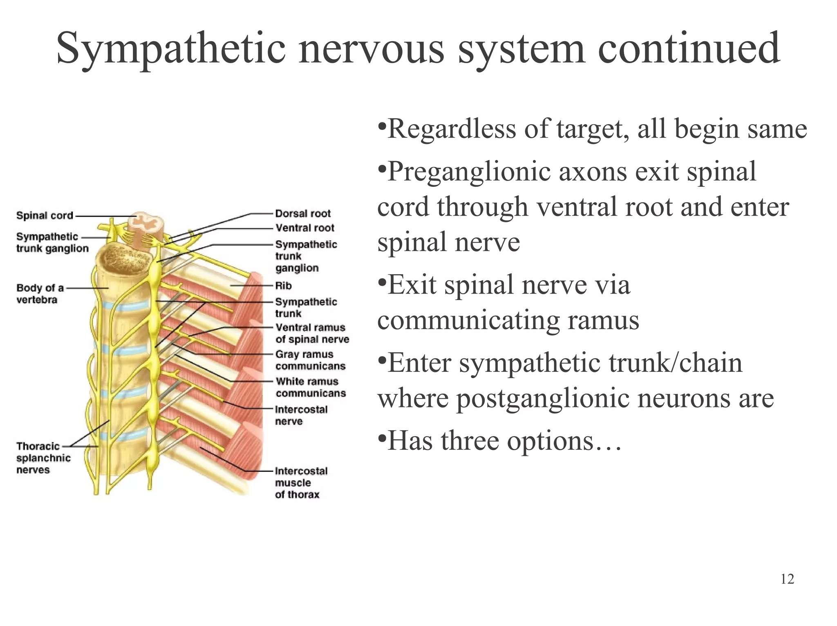

Slide 22
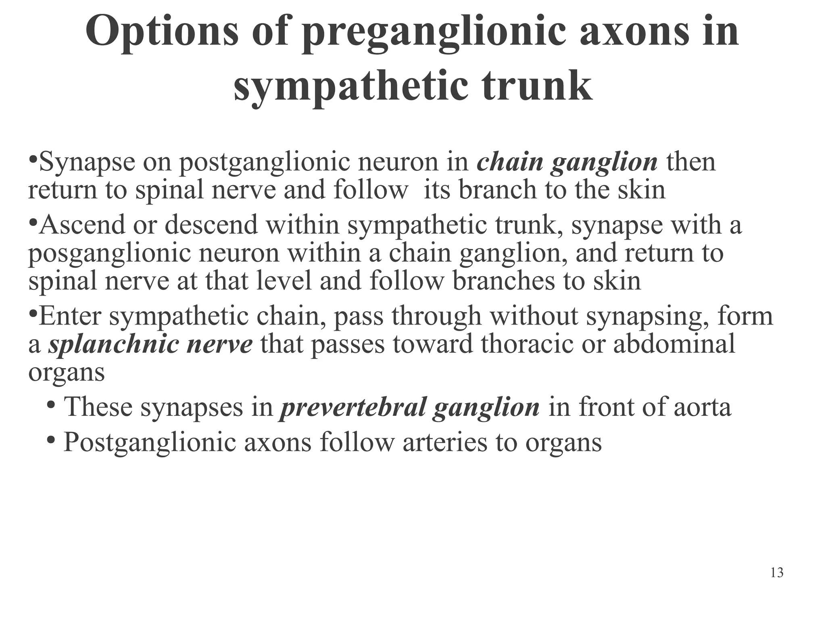

Slide 23
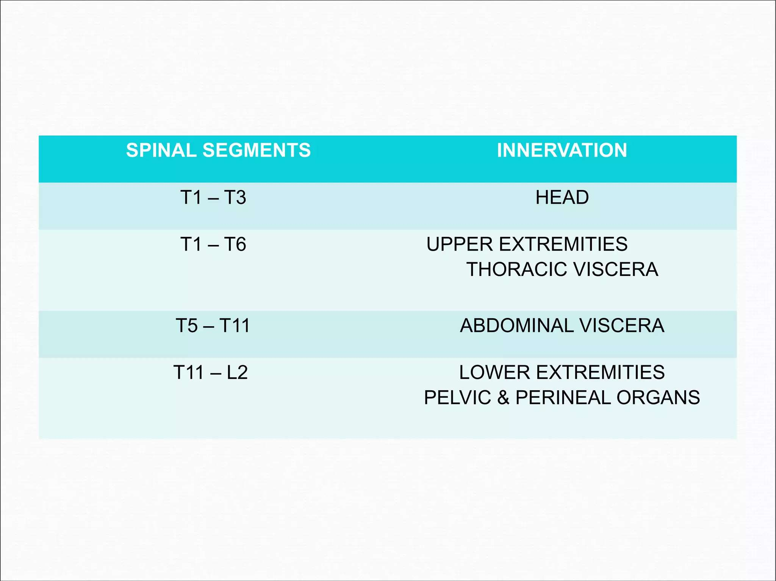

Slide 24
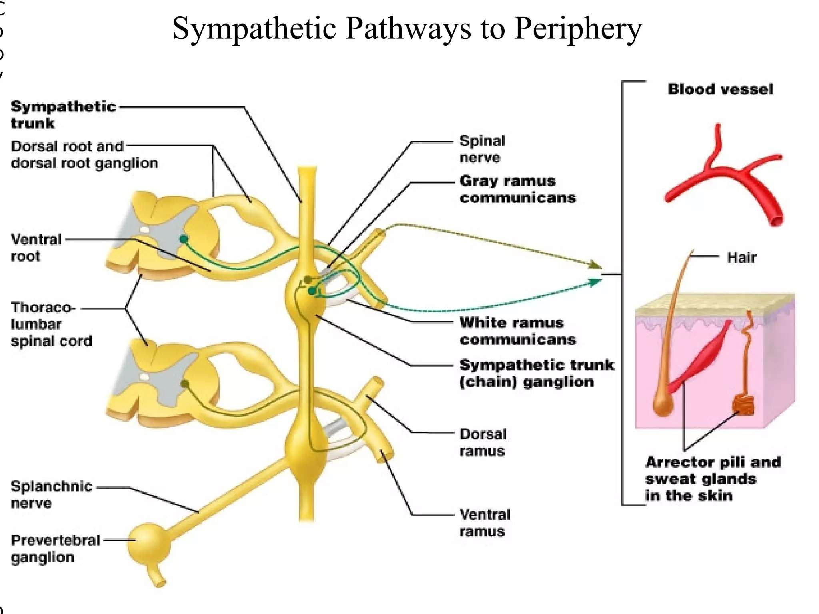

Slide 25
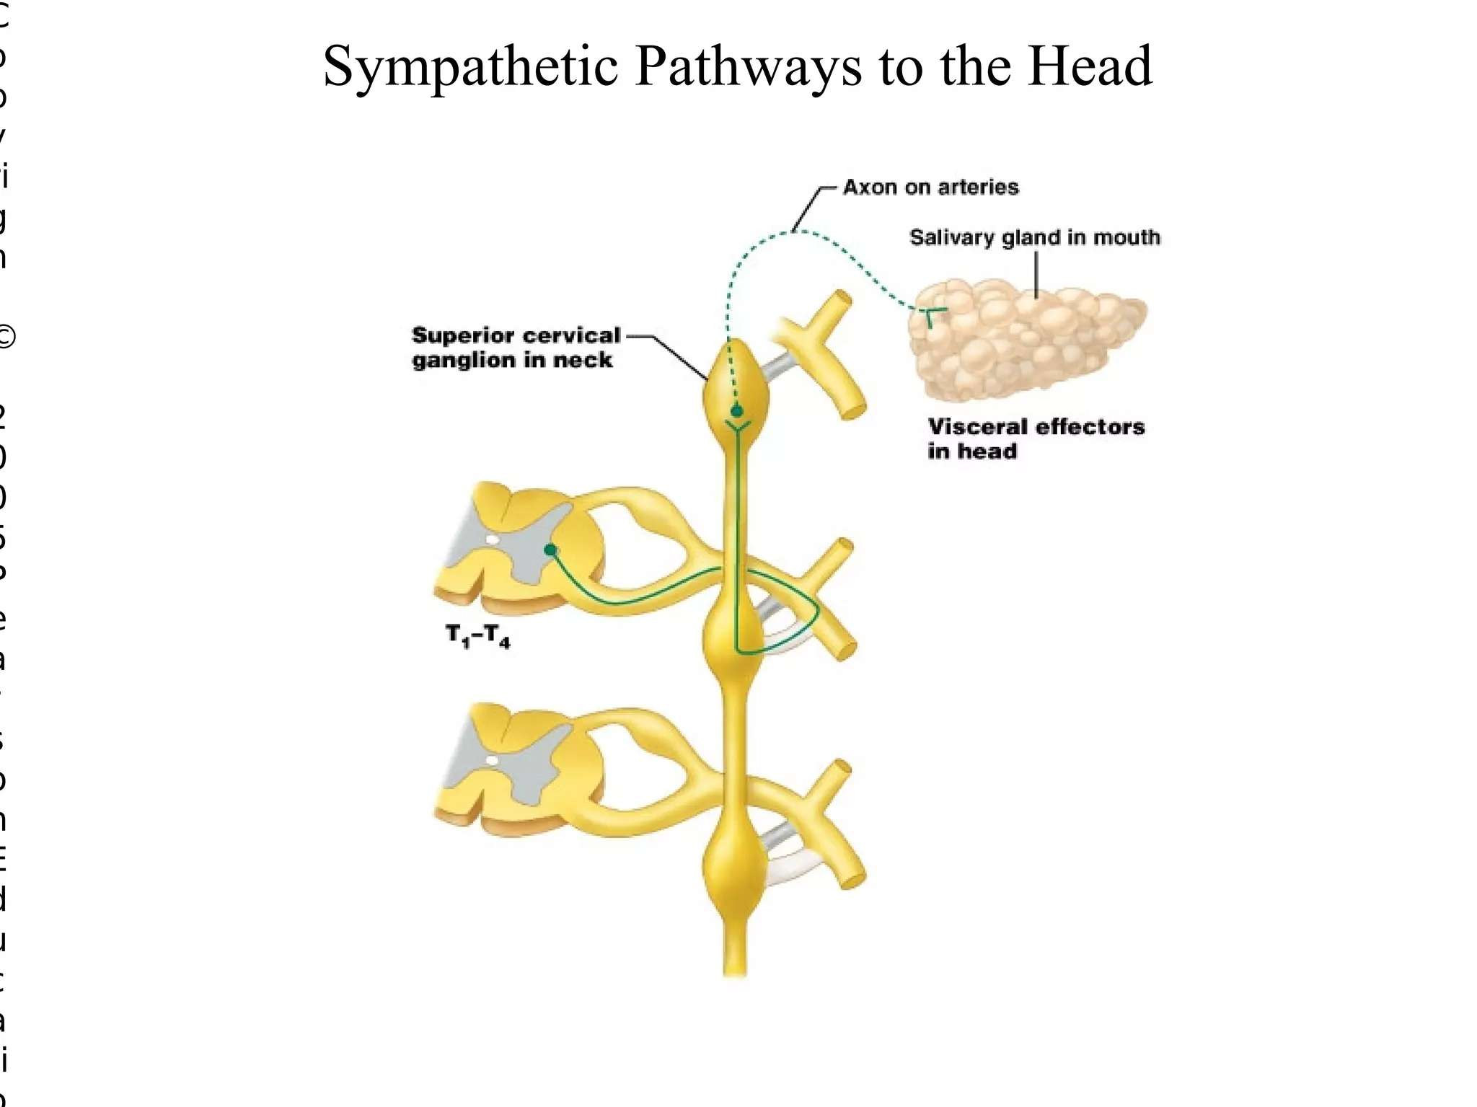

Slide 26
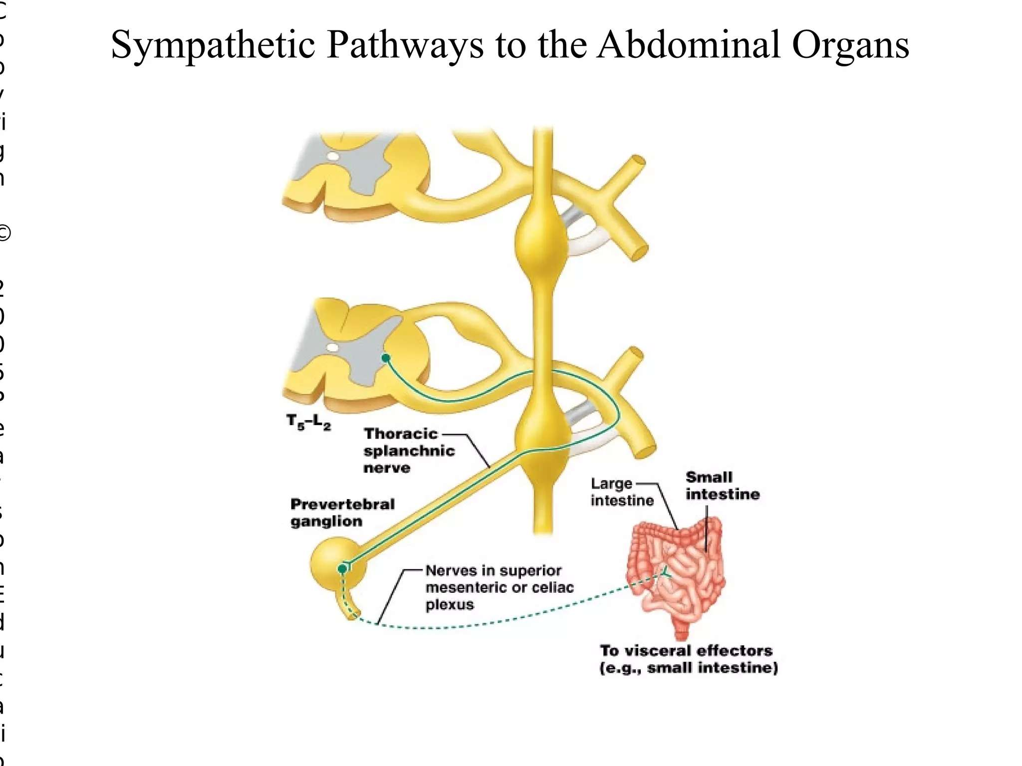

Slide 27
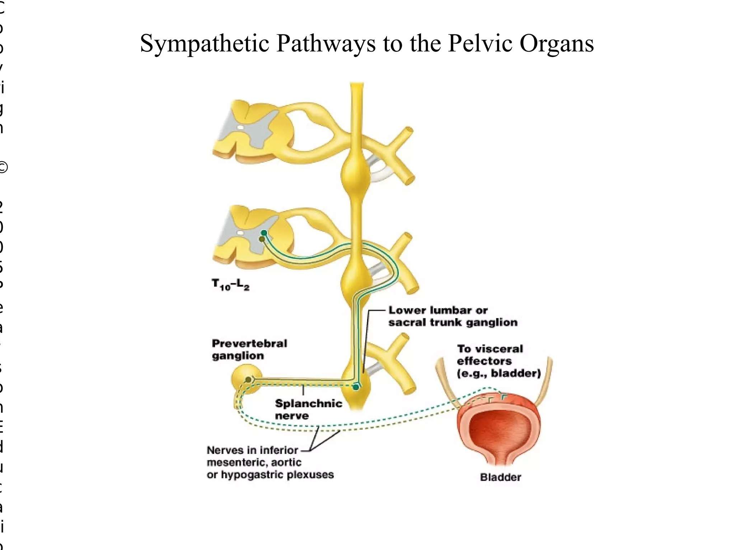

Slide 28
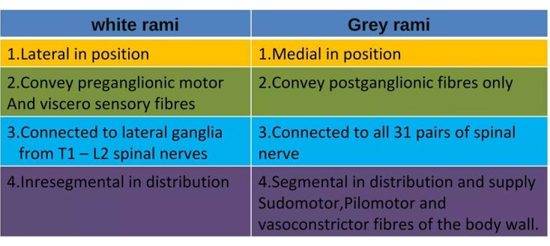

Slide 29
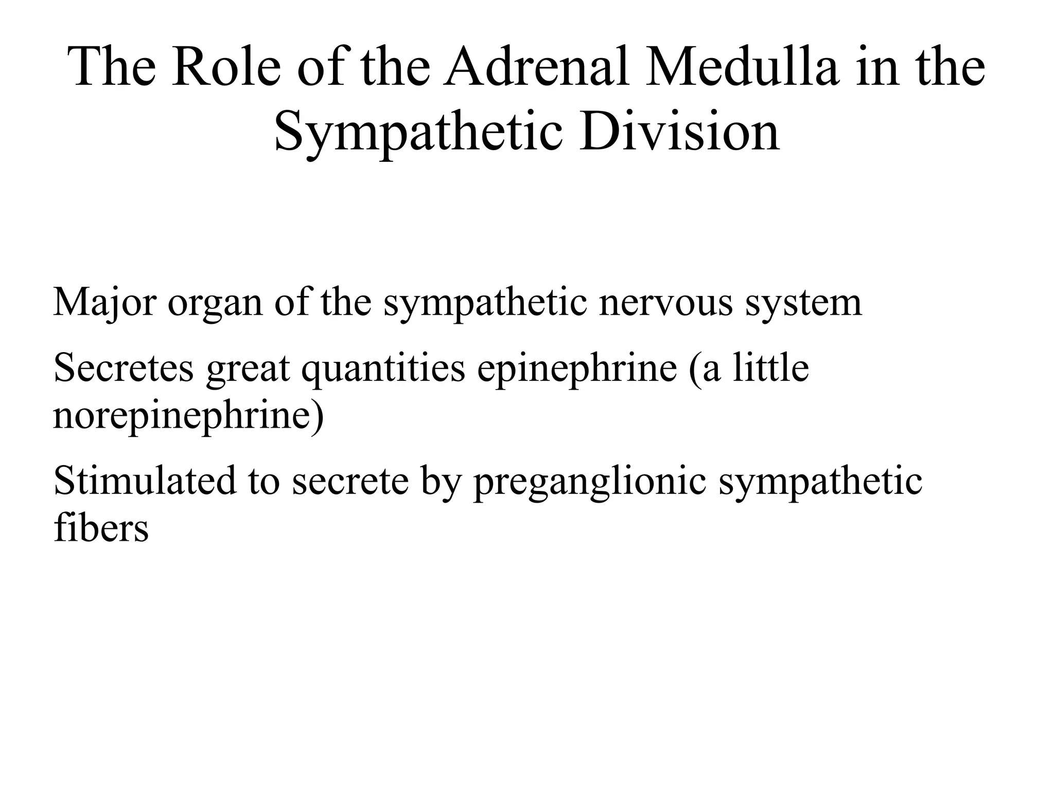

Slide 30
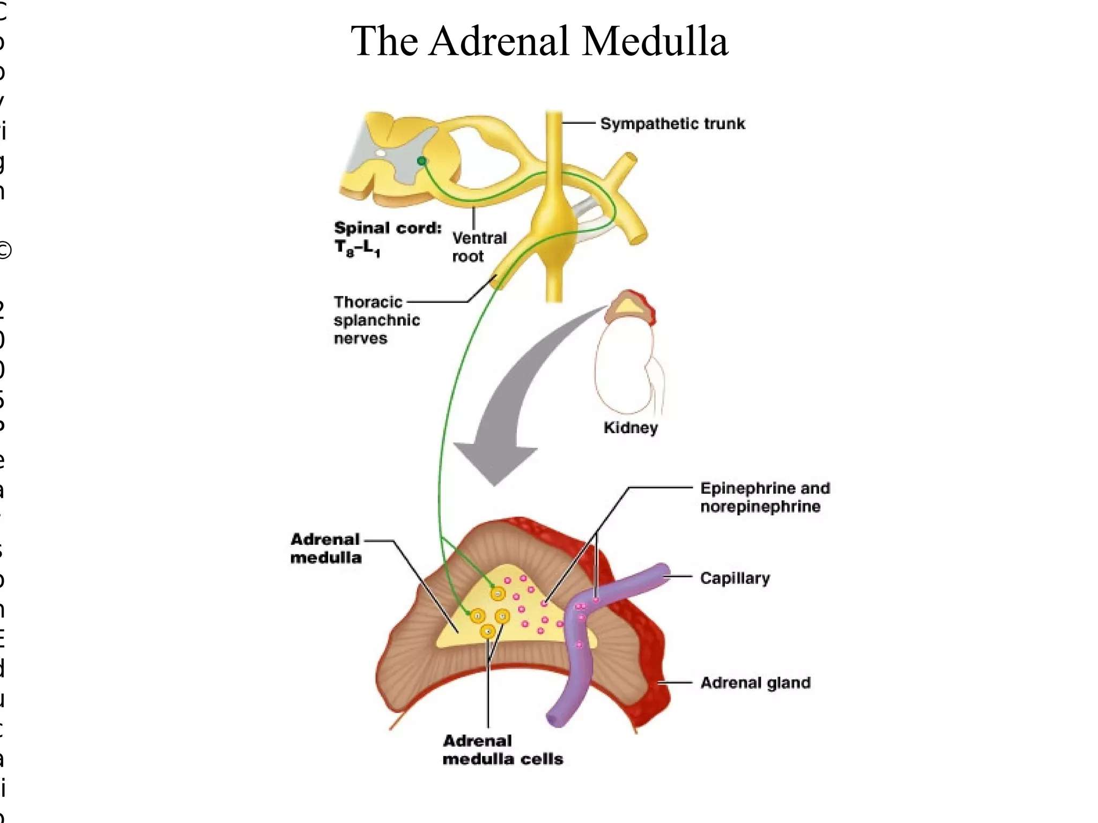

Slide 31
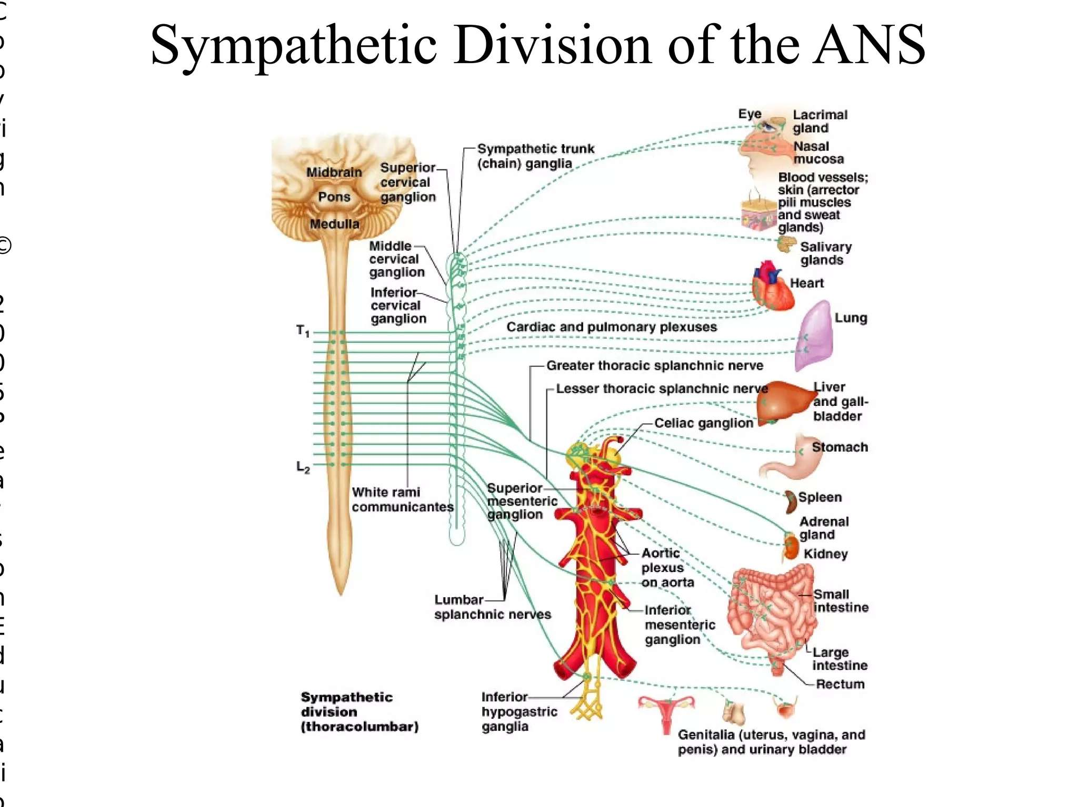

Slide 32
Parasympathetic Nervous System

Slide 33
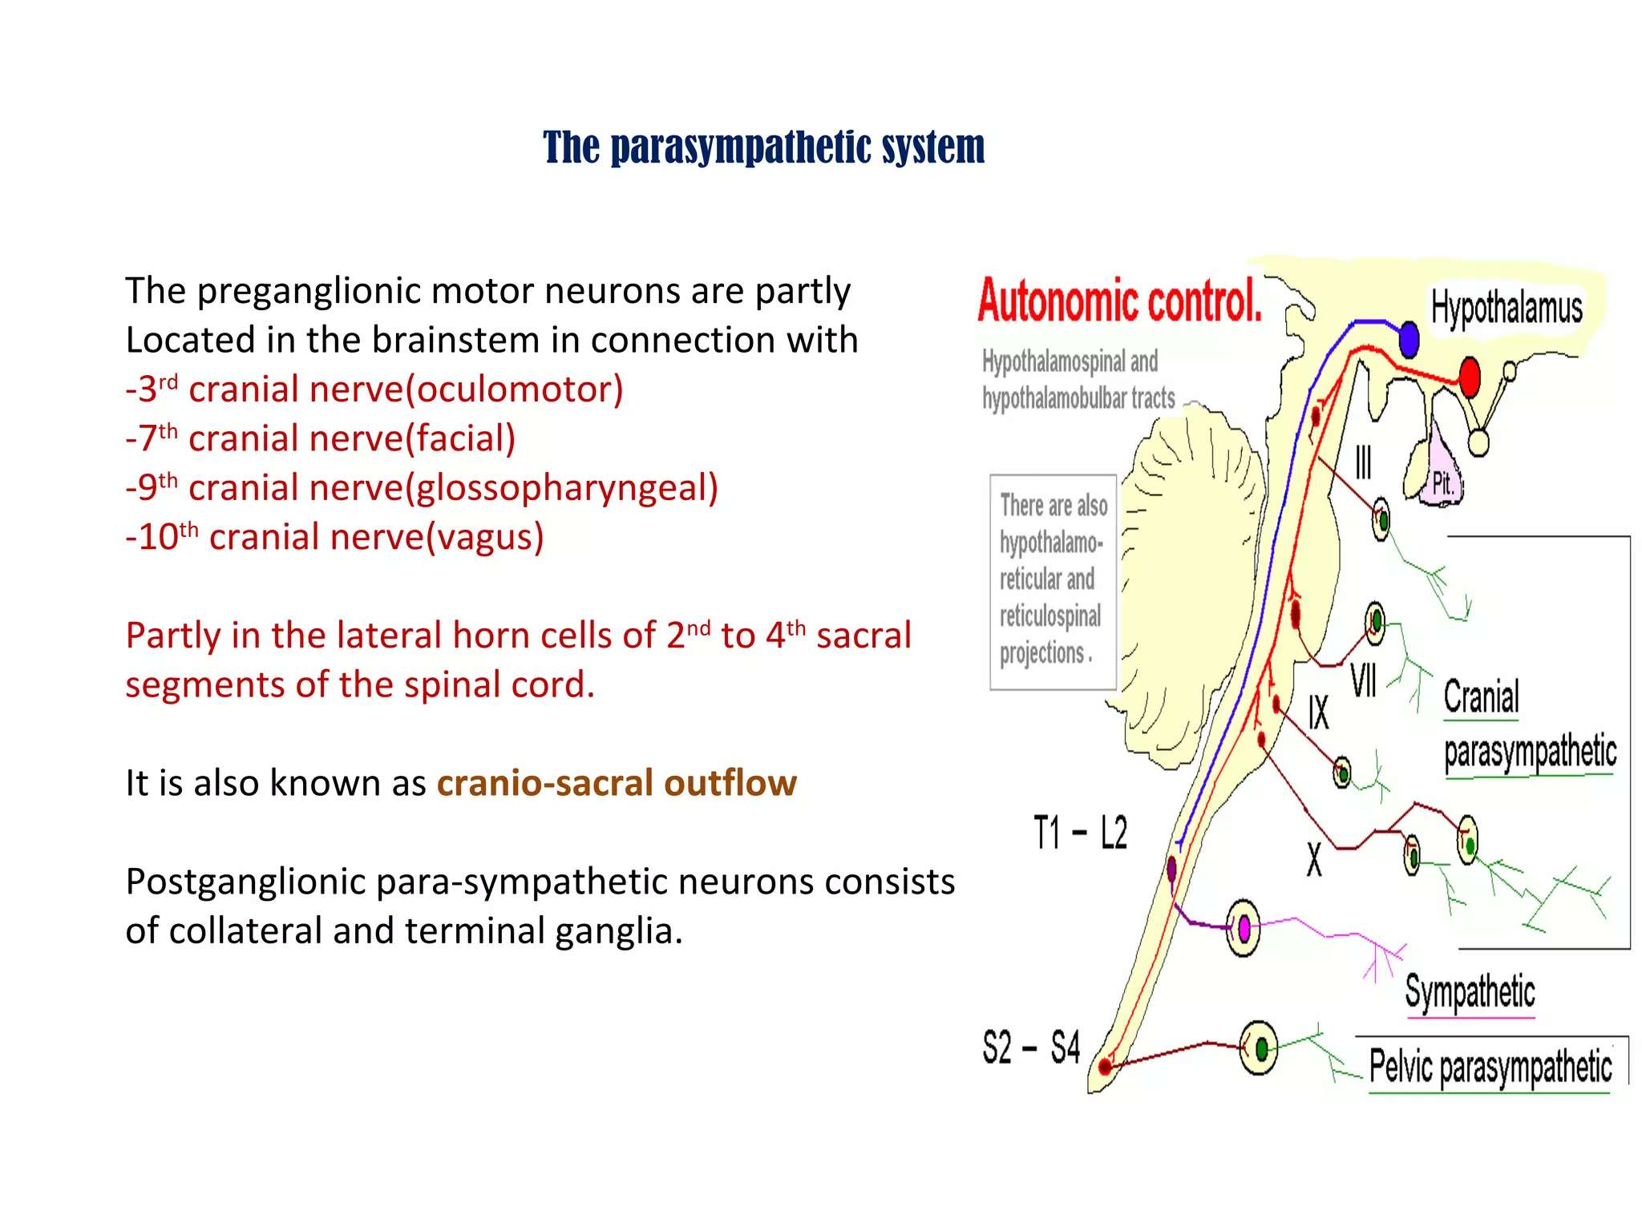

Slide 34
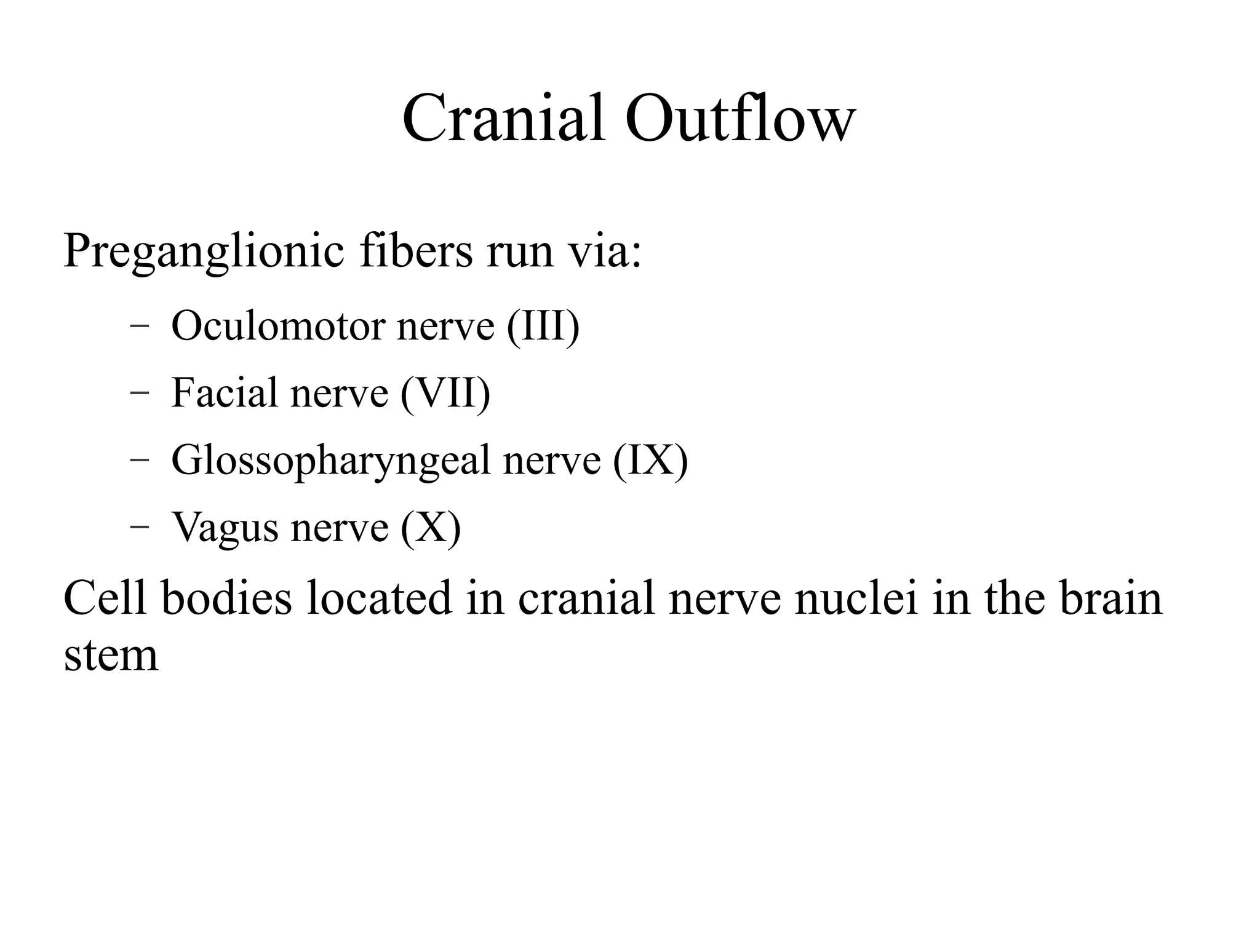

Slide 35
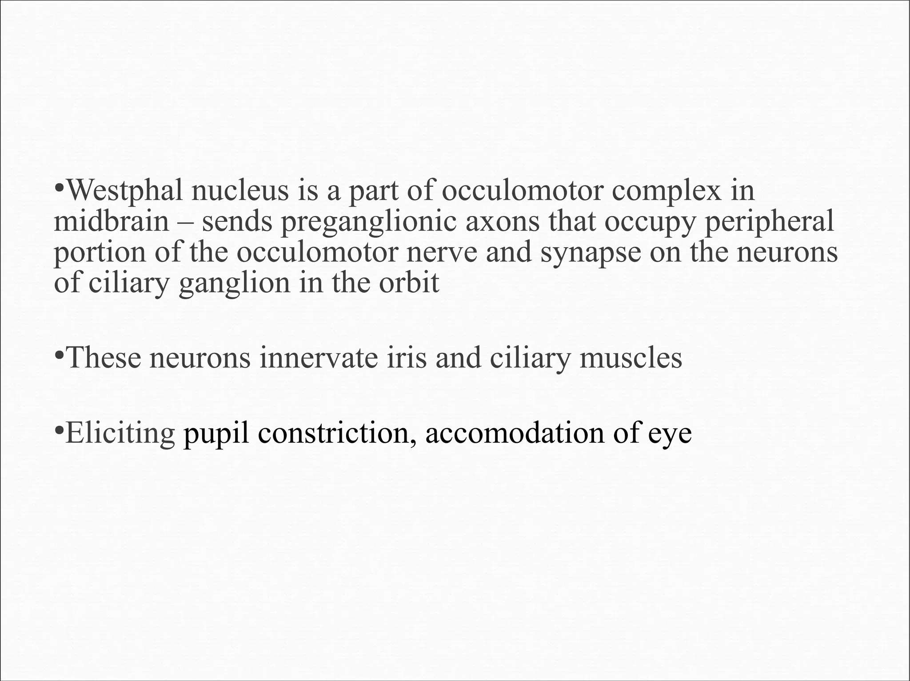

Slide 36
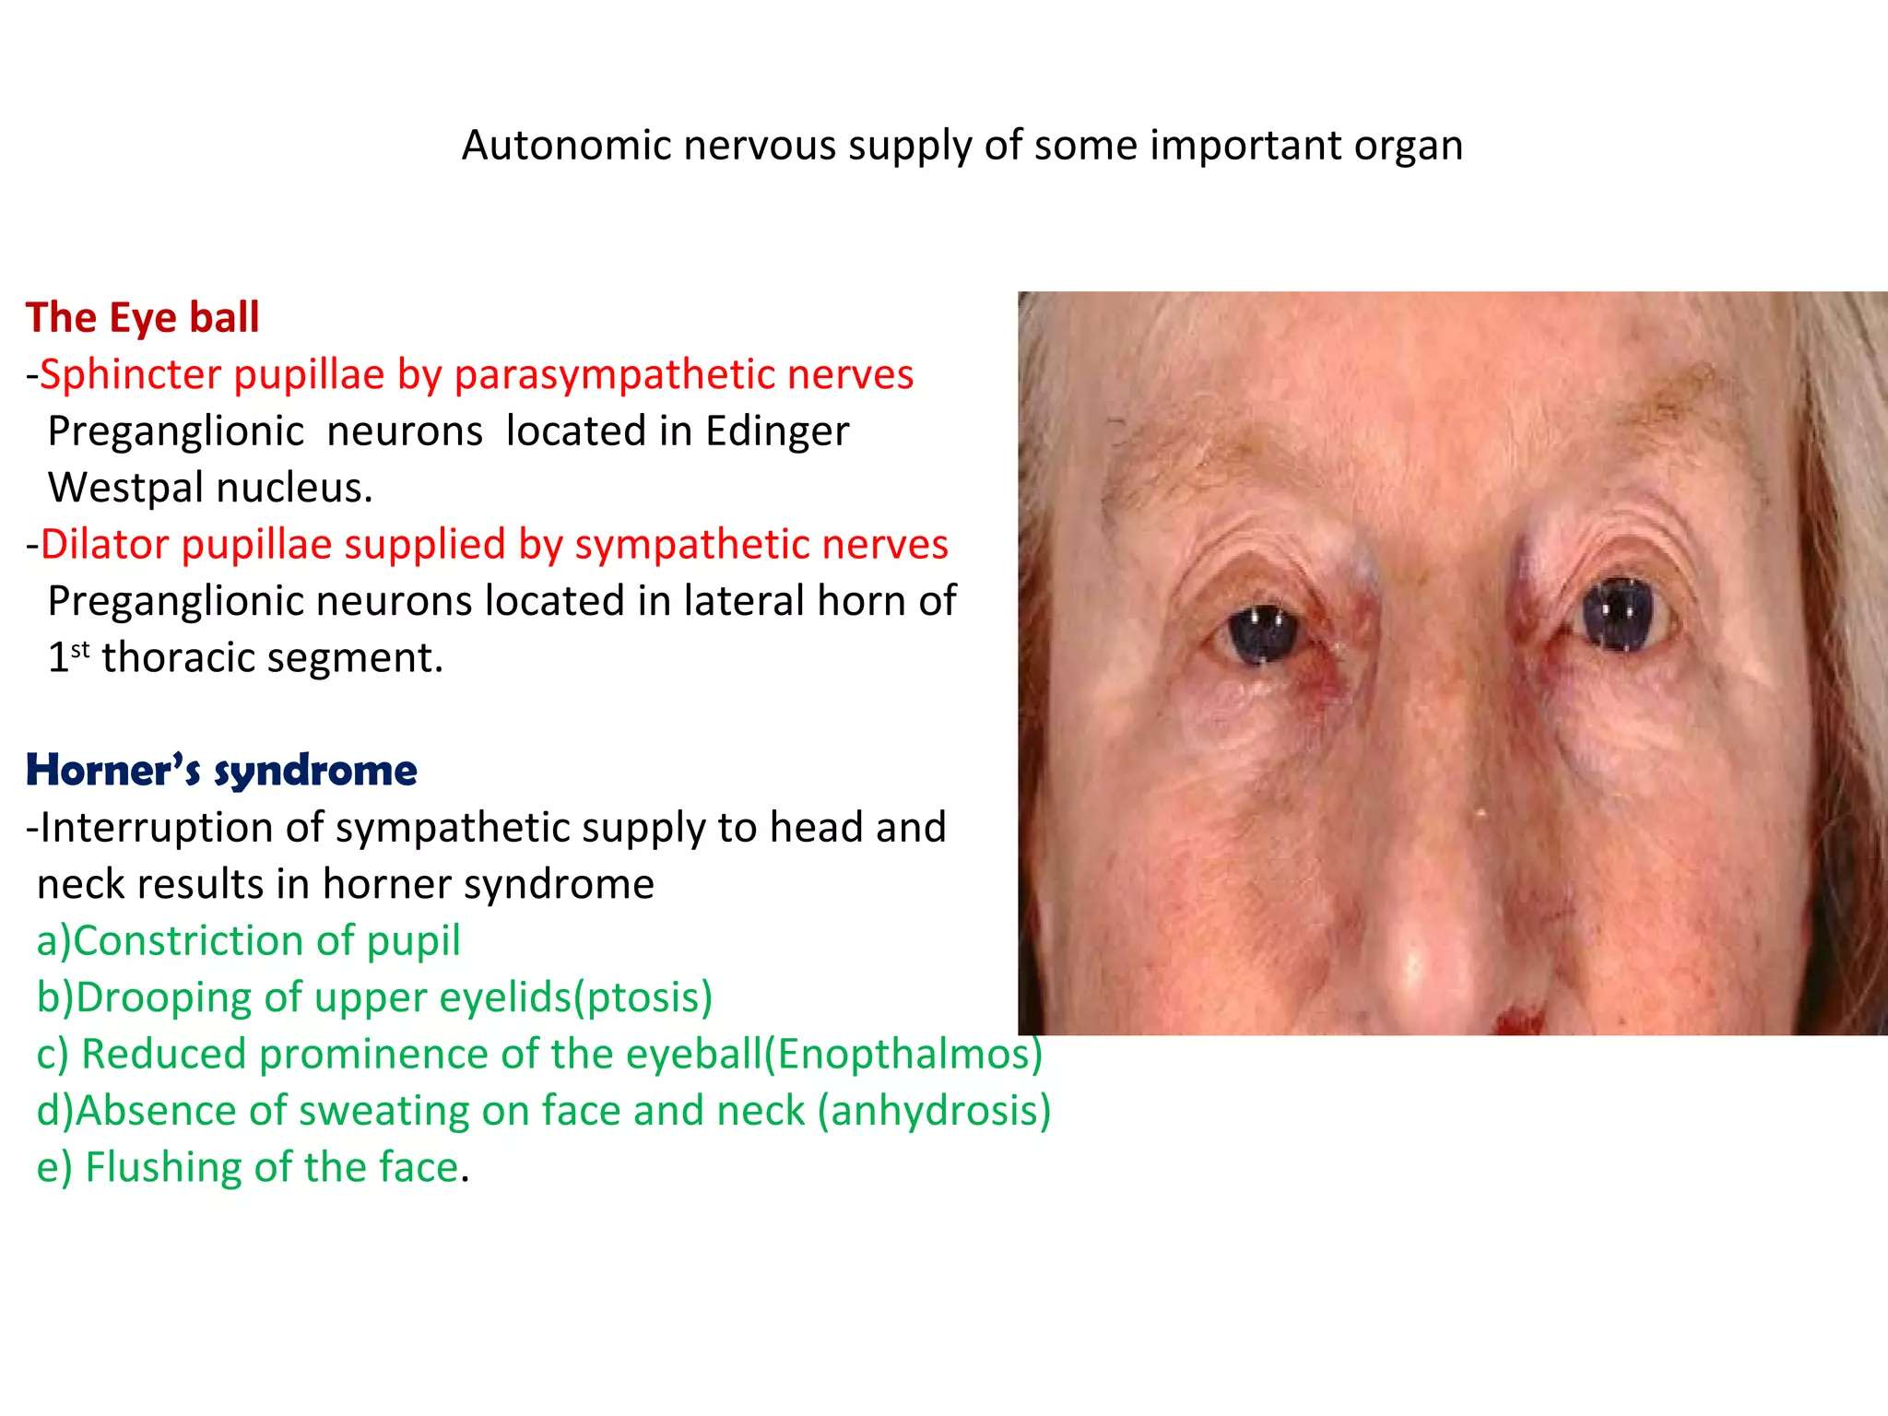

Slide 37
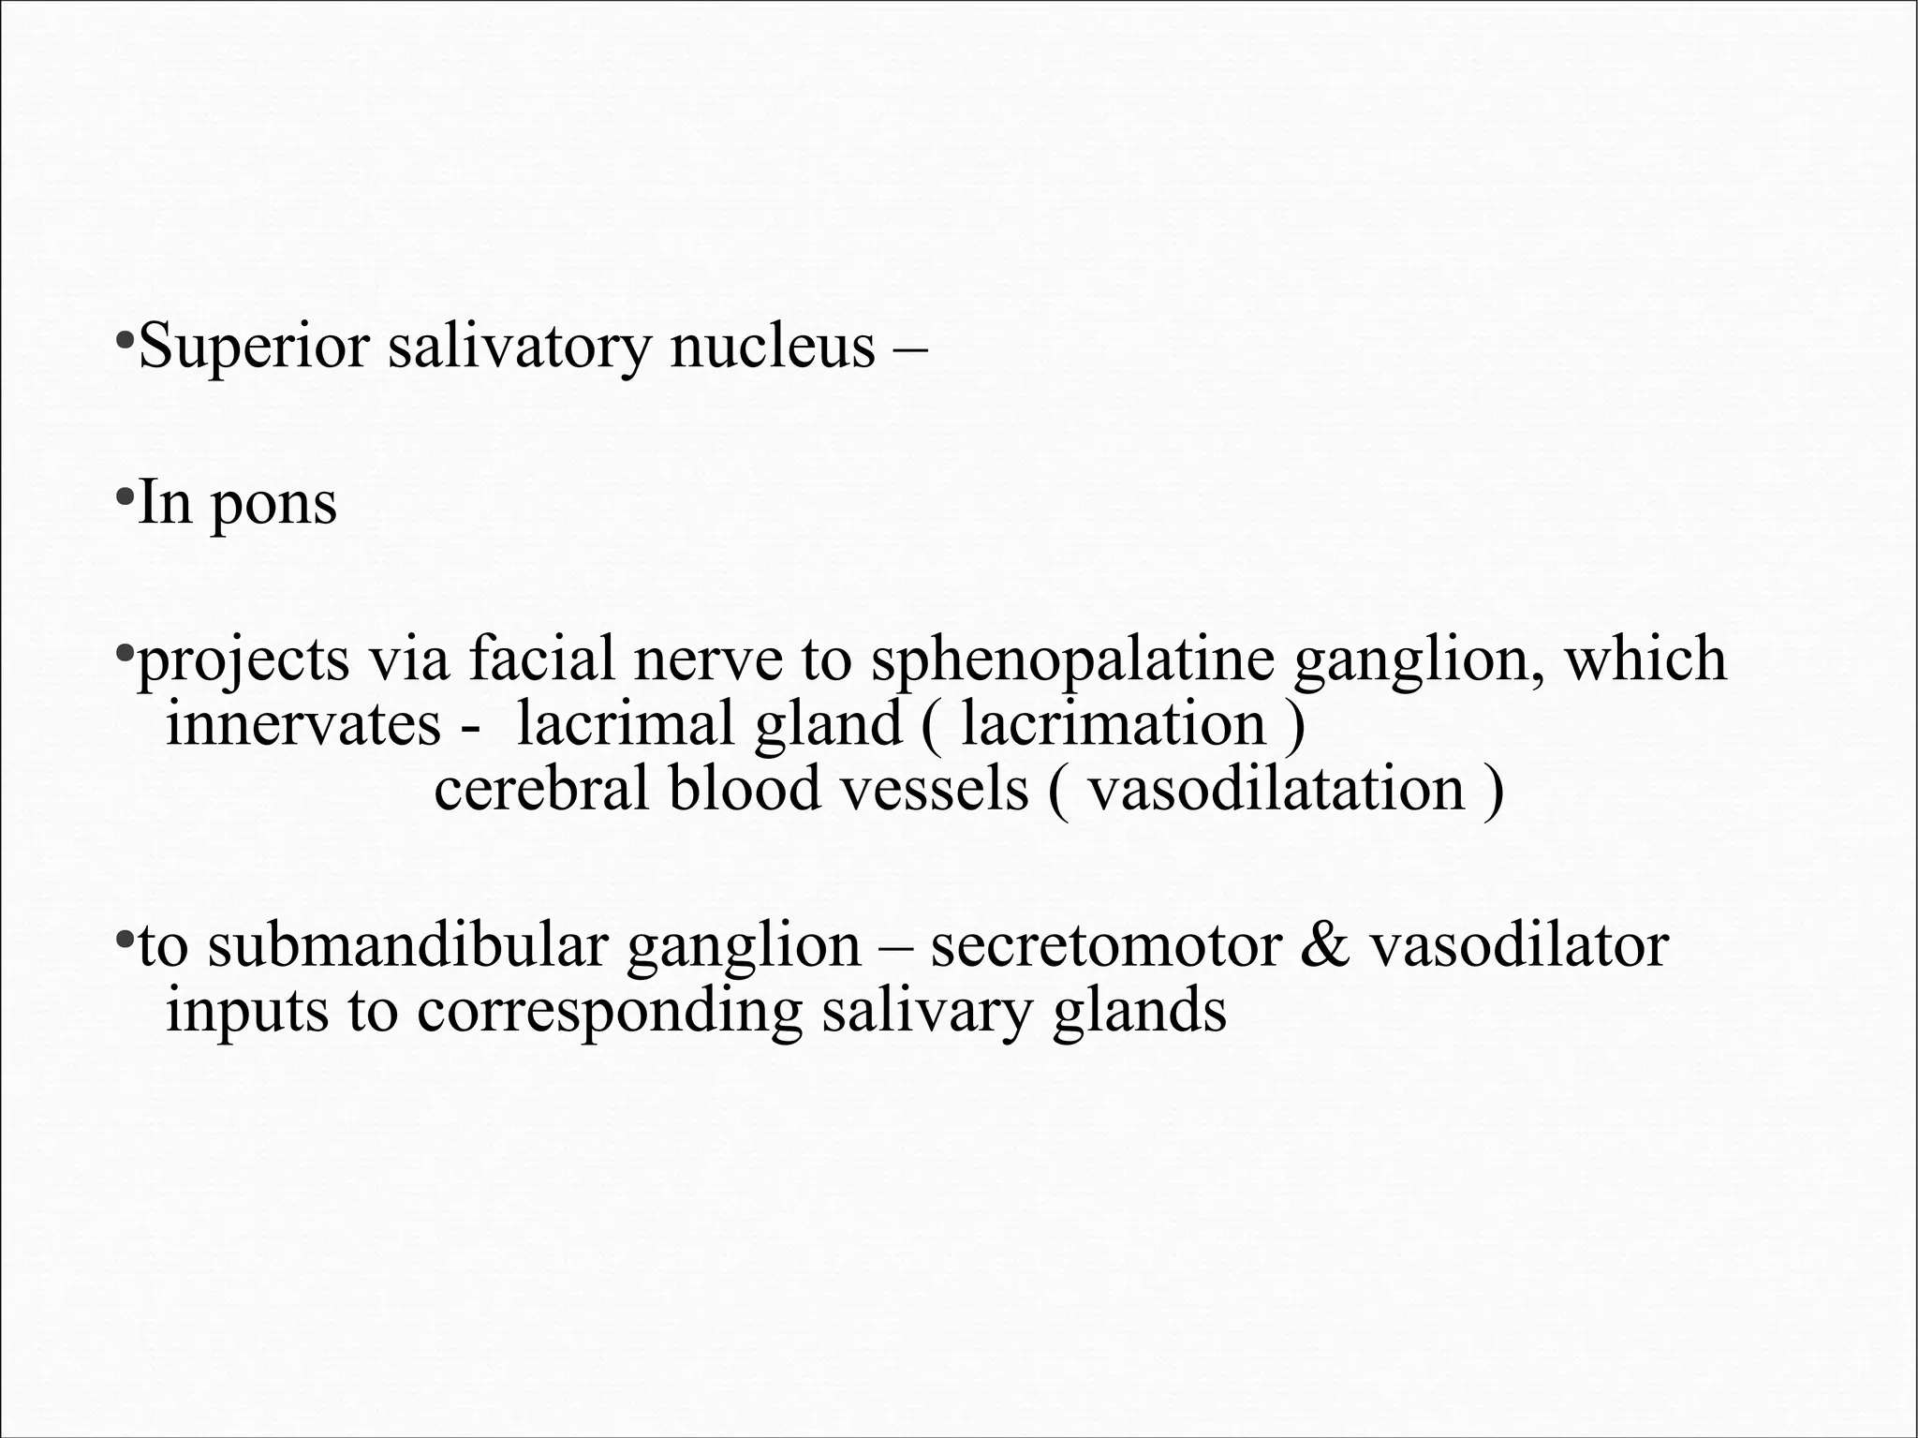

Slide 38
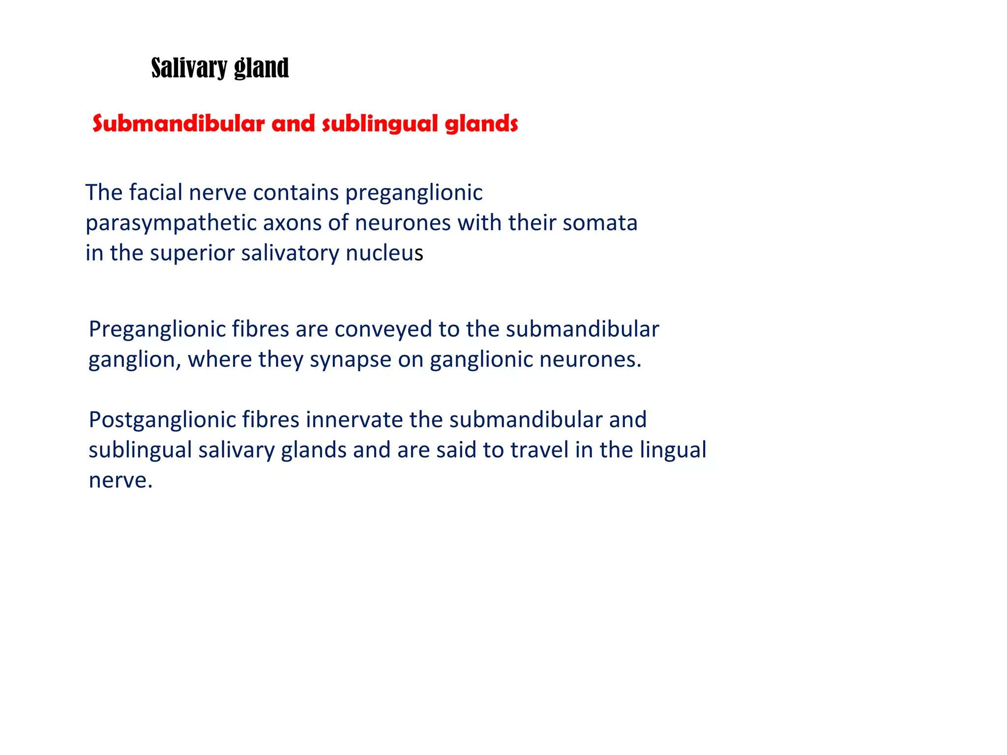

Slide 39
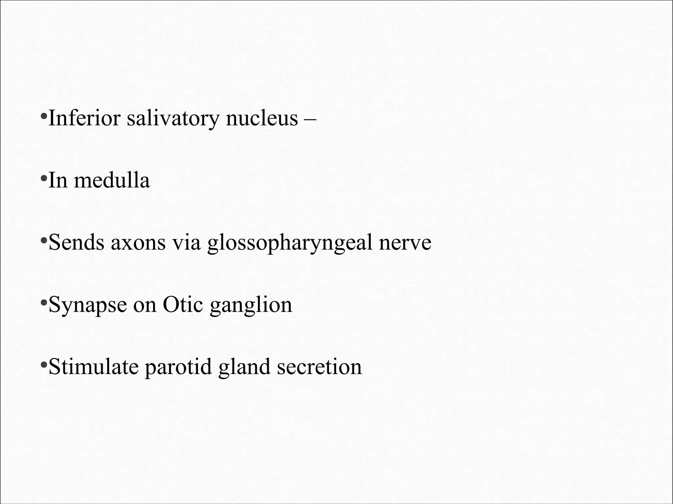

Slide 40
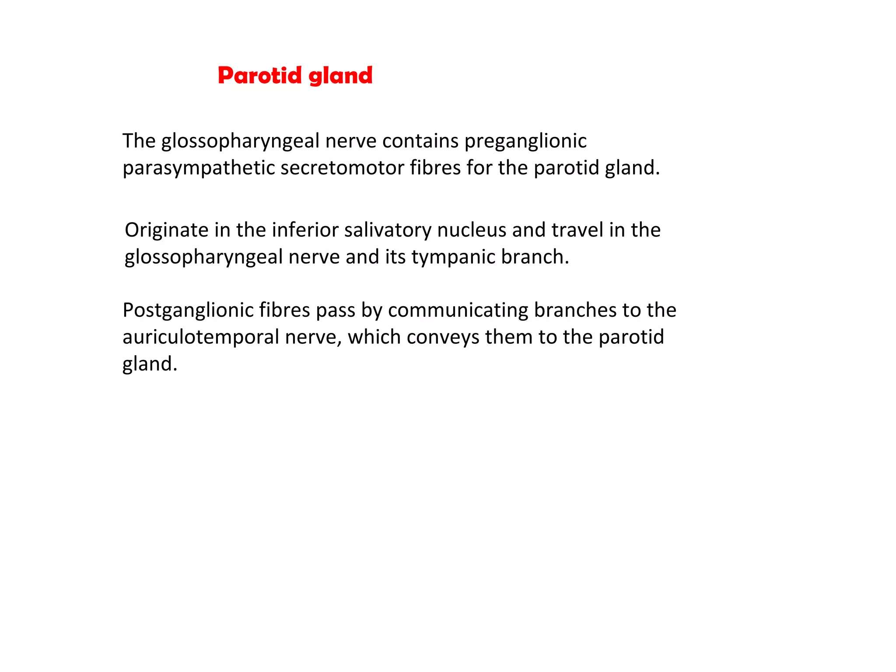

Slide 41
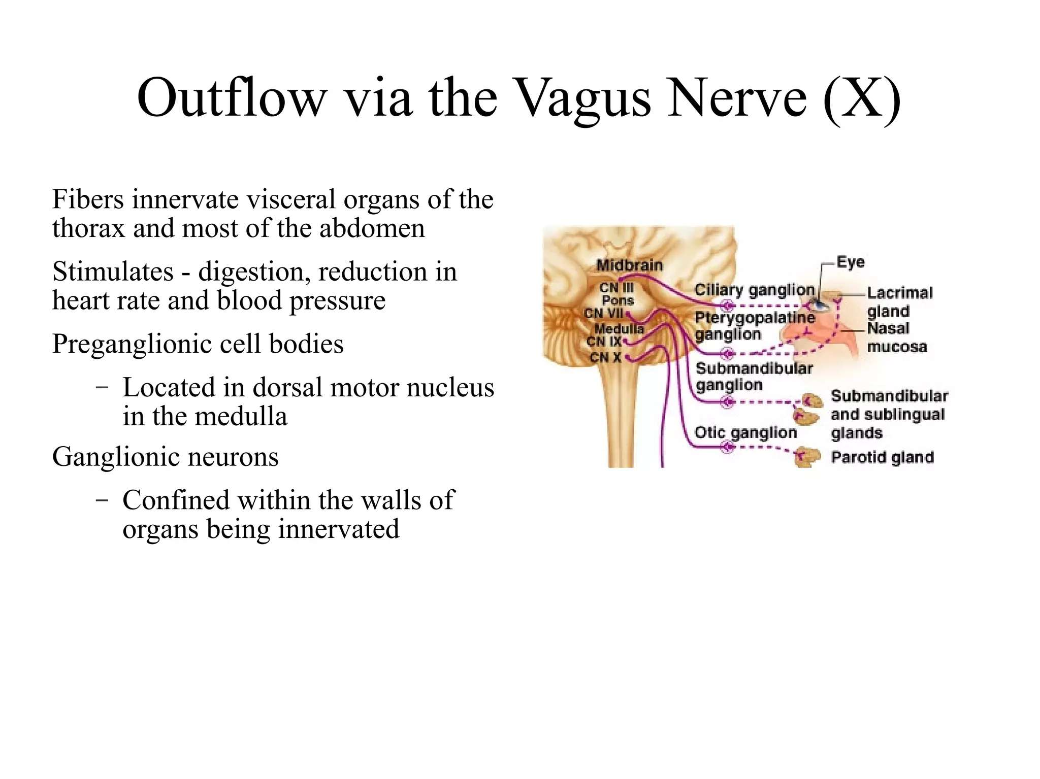

Slide 42
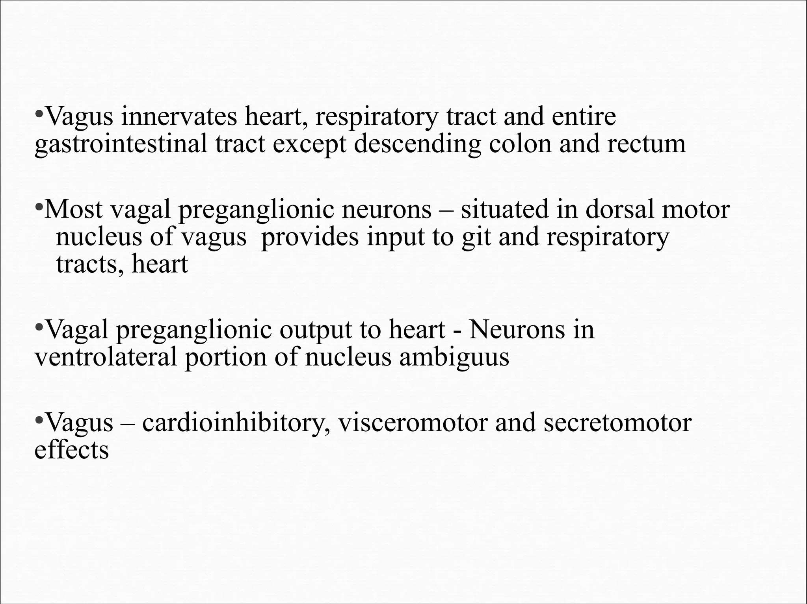

Slide 43
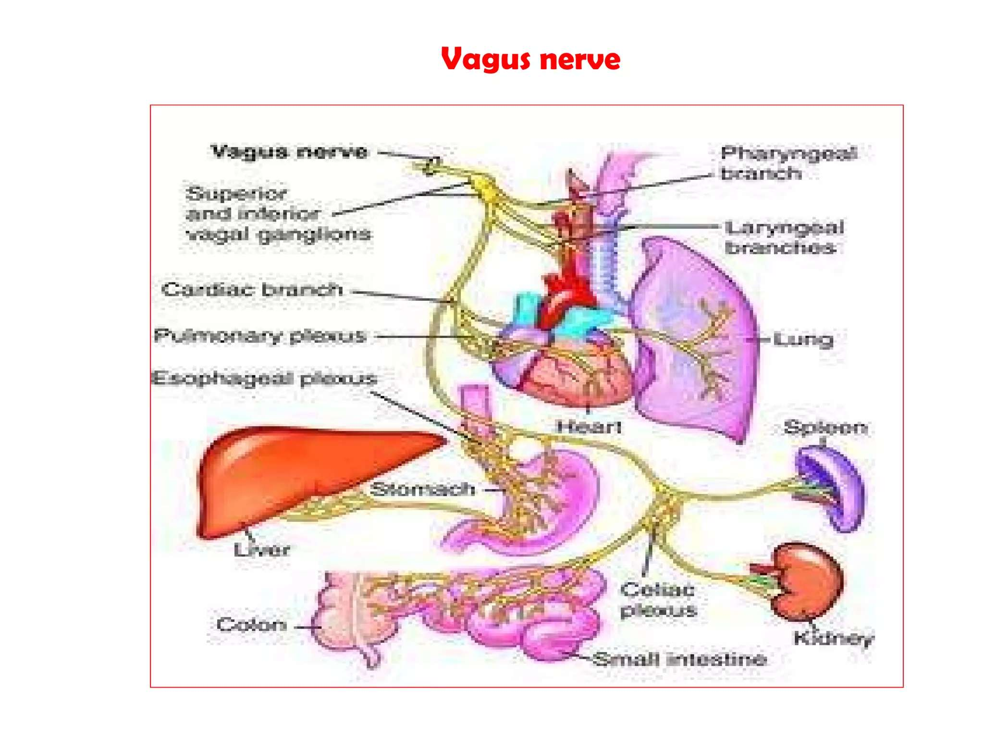

Slide 44
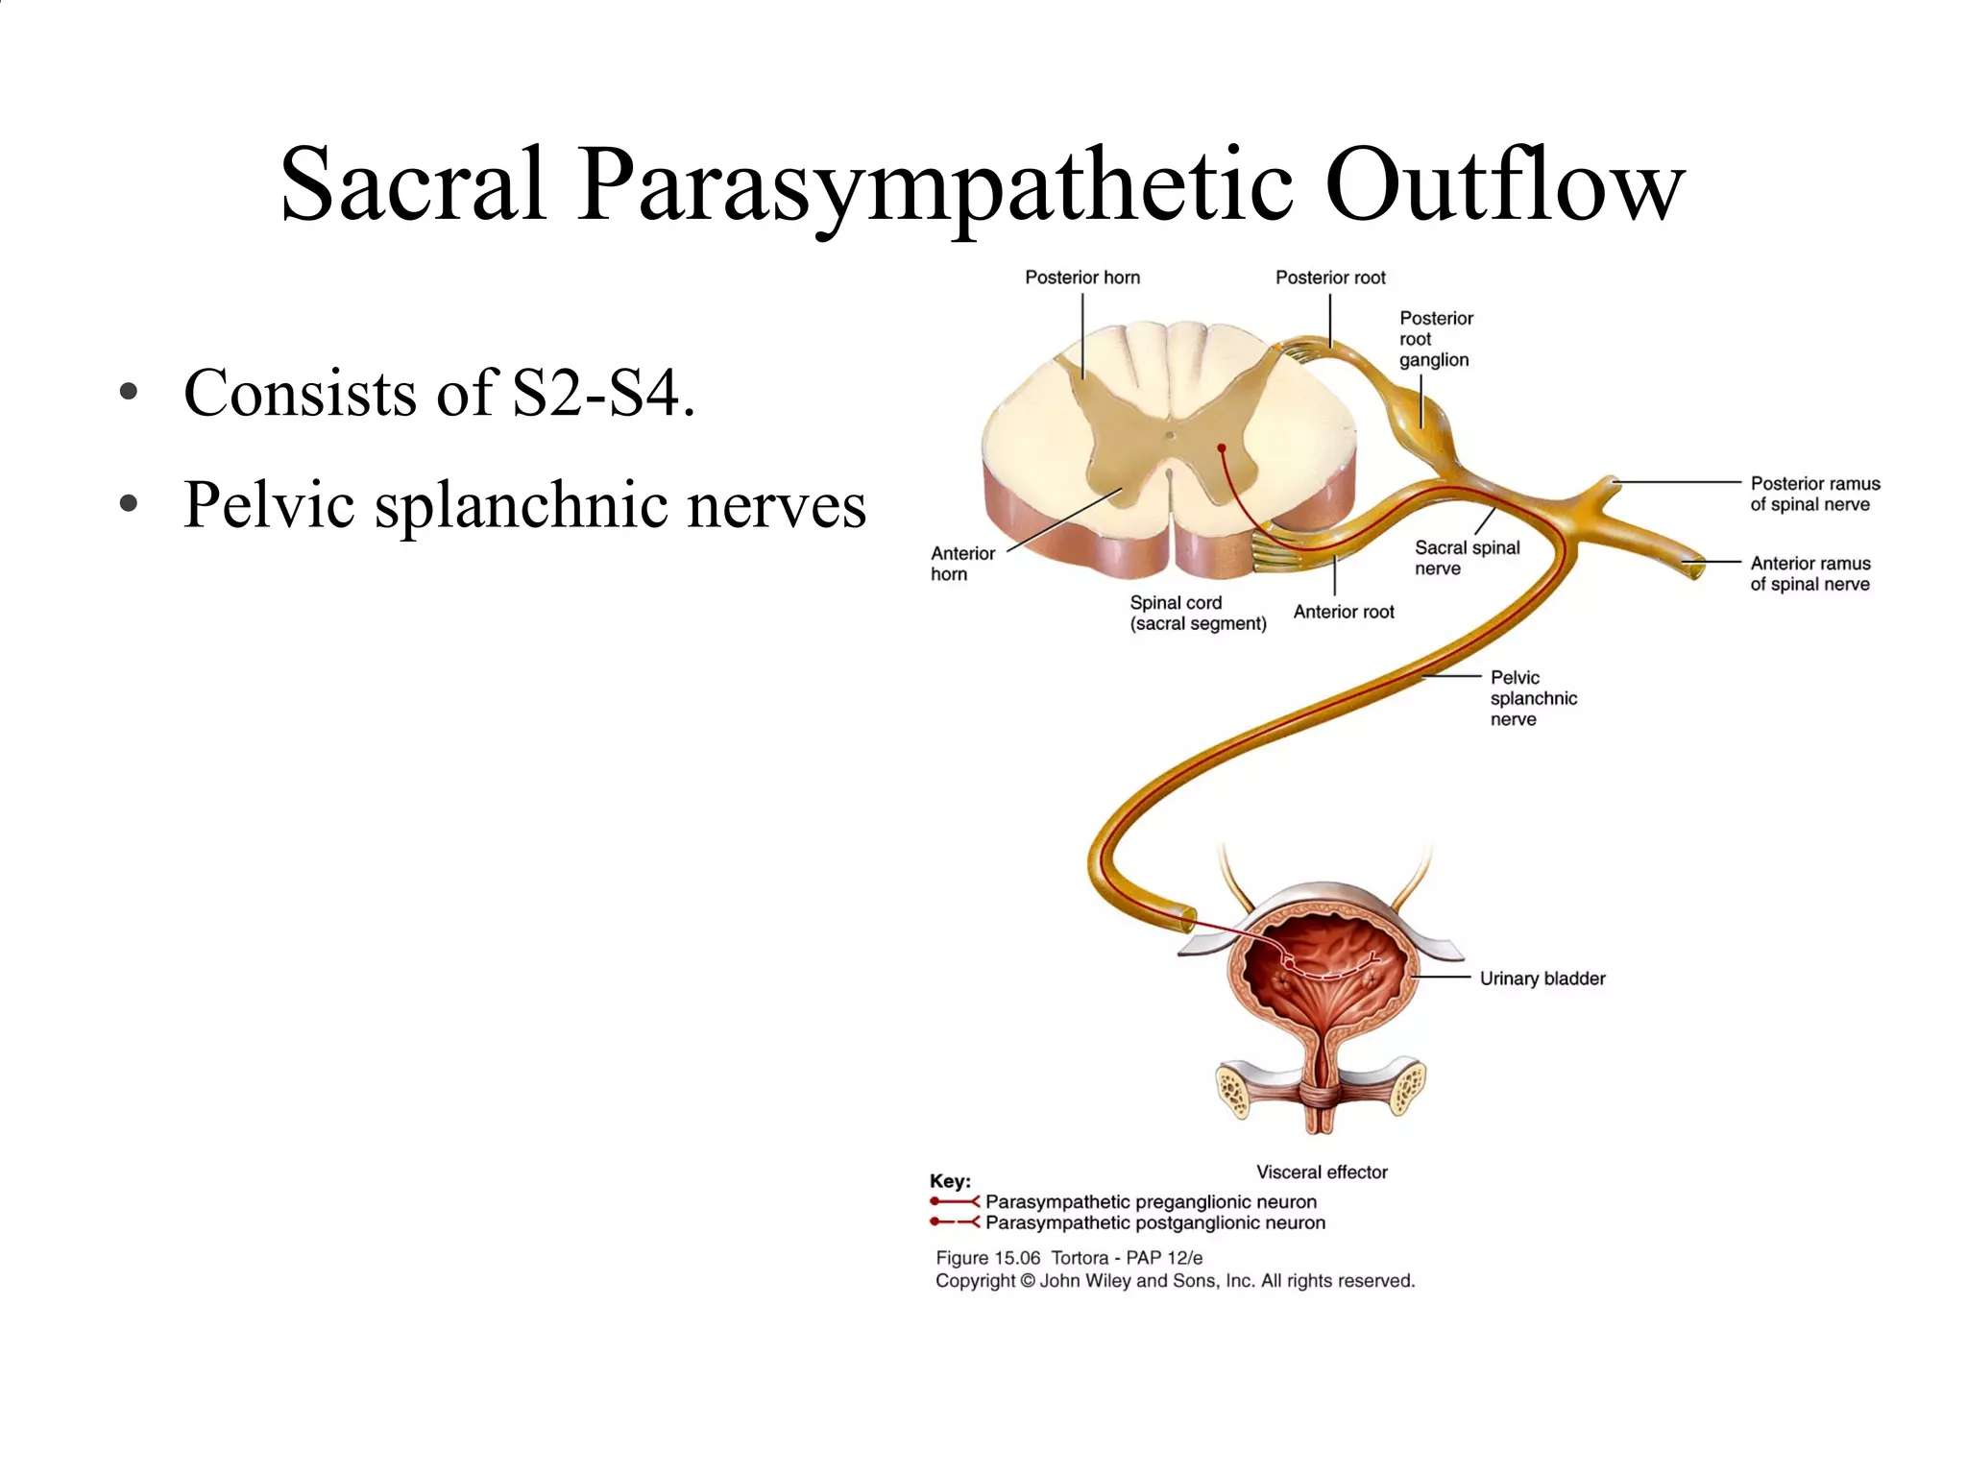

Slide 45
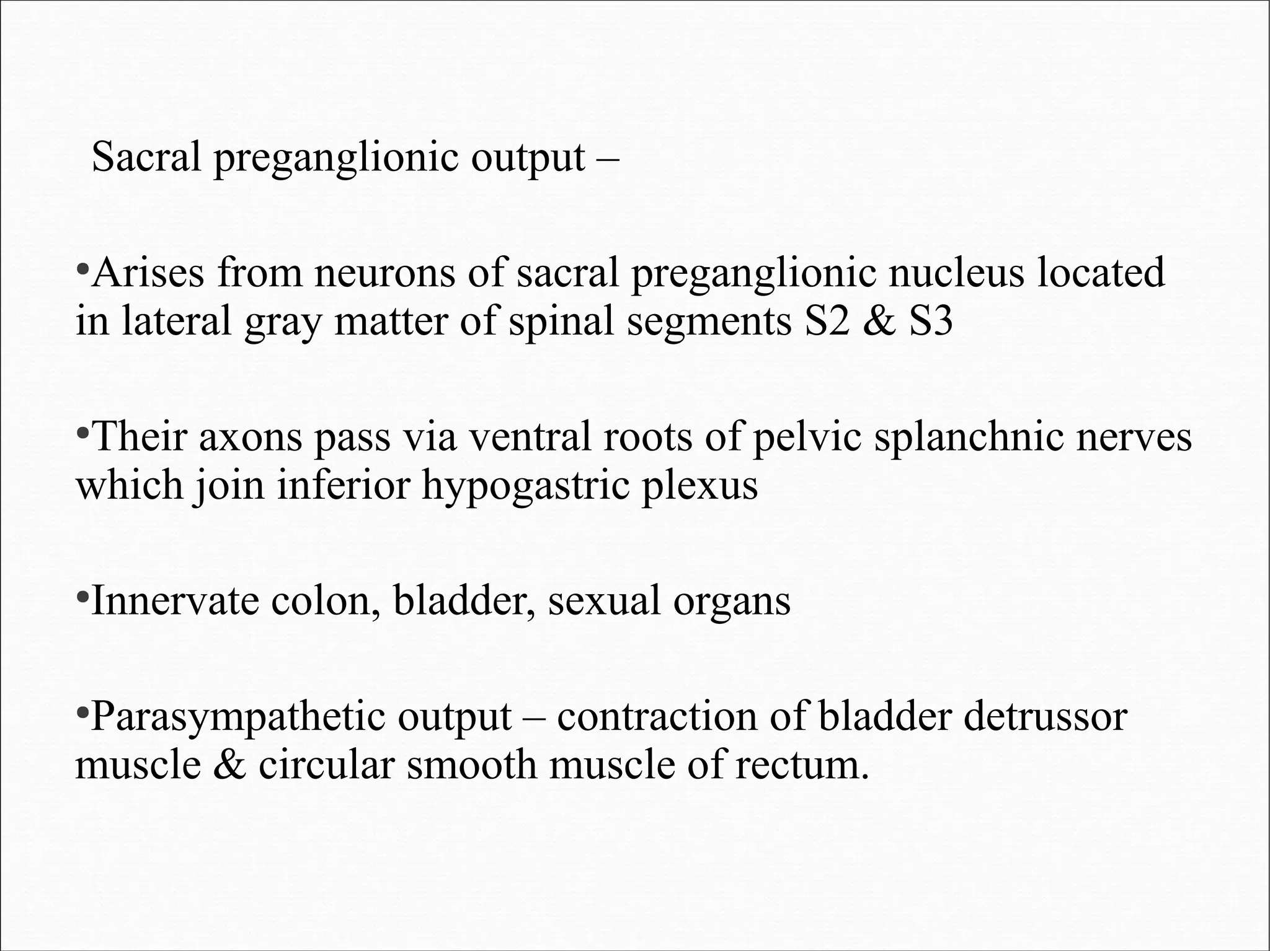

Slide 46
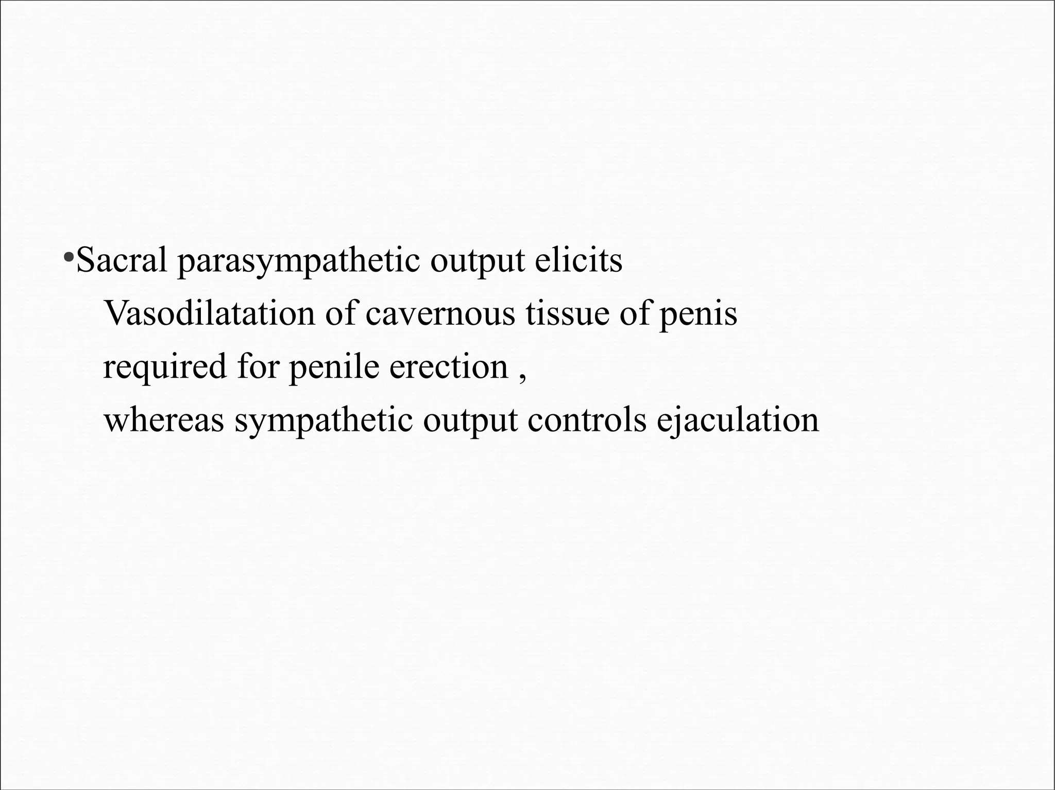

Slide 47
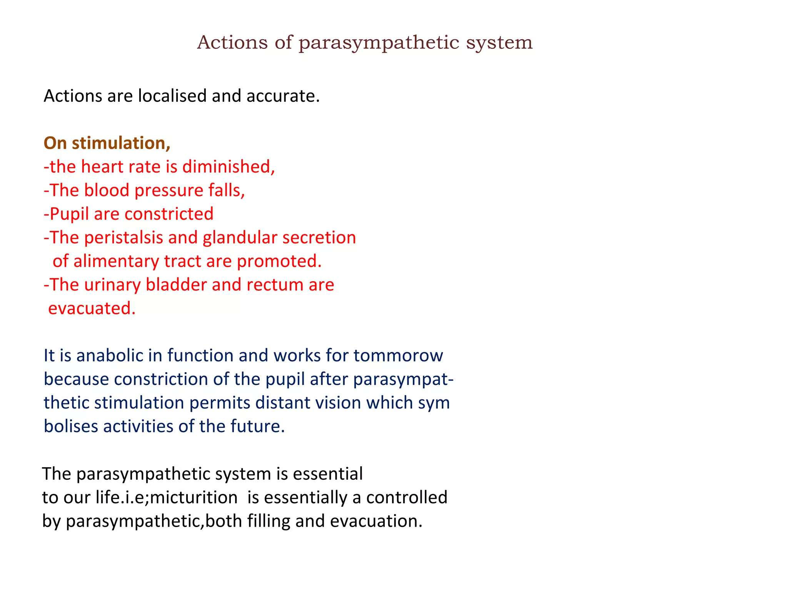

Slide 48
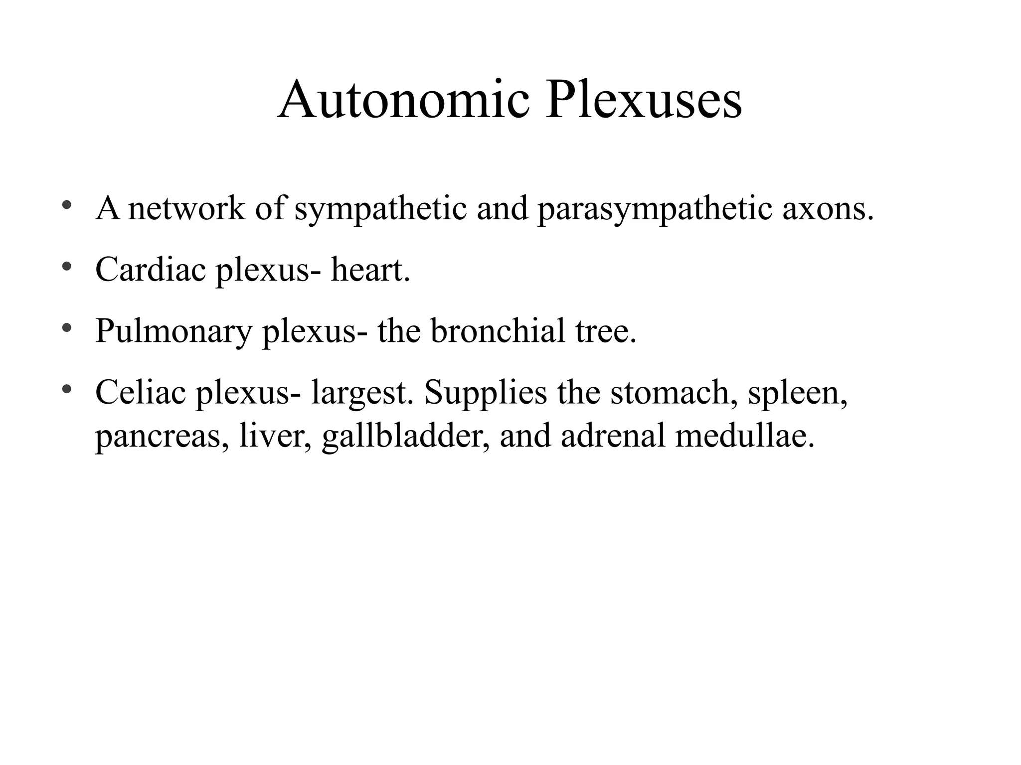

Slide 49
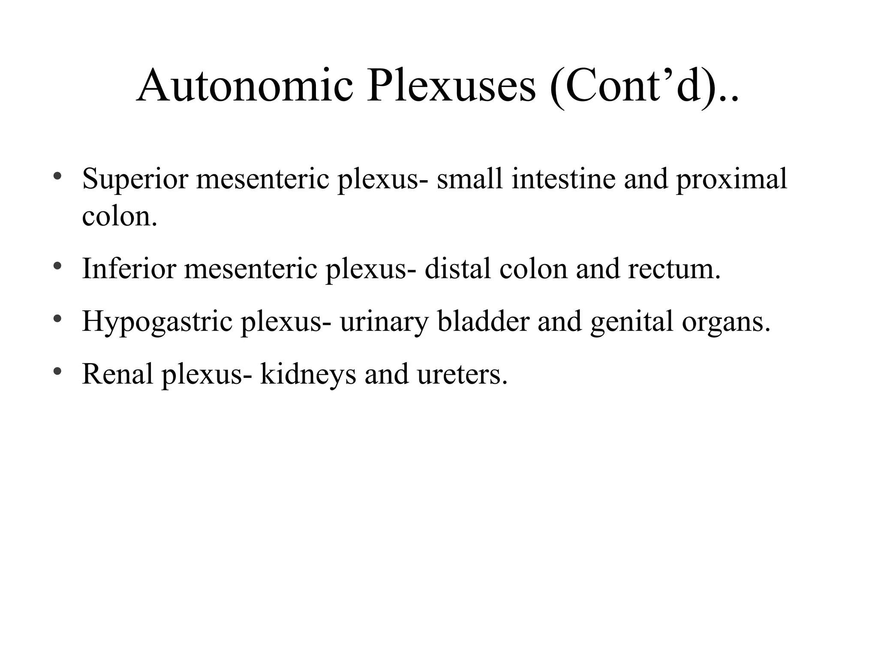

Slide 50
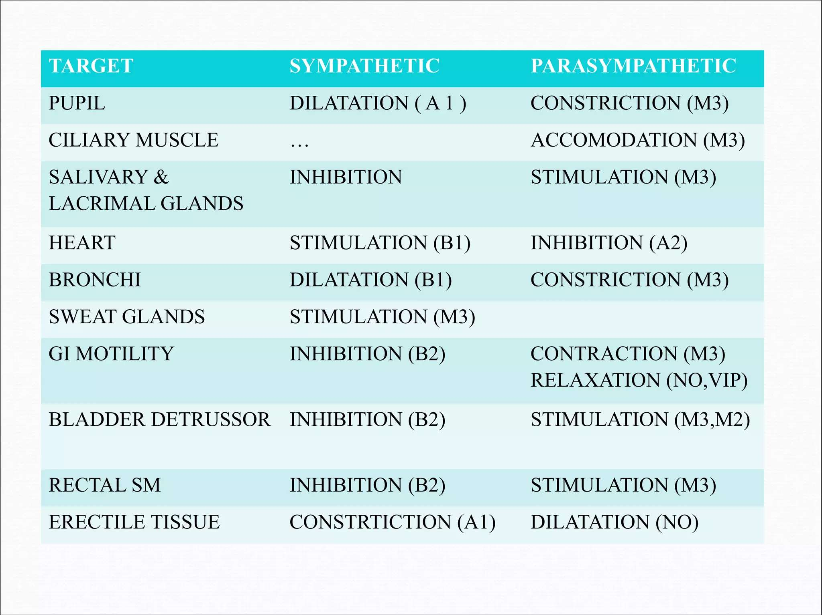

Slide 51
ENTERIC NERVOUS SYSTEM
Subdivision of ANS in the GI tract
Myenteric (Auerbach’s) and Submucosal (Meissner’s) plexuses
Functions semi-independently but modulated by ANS

Slide 52
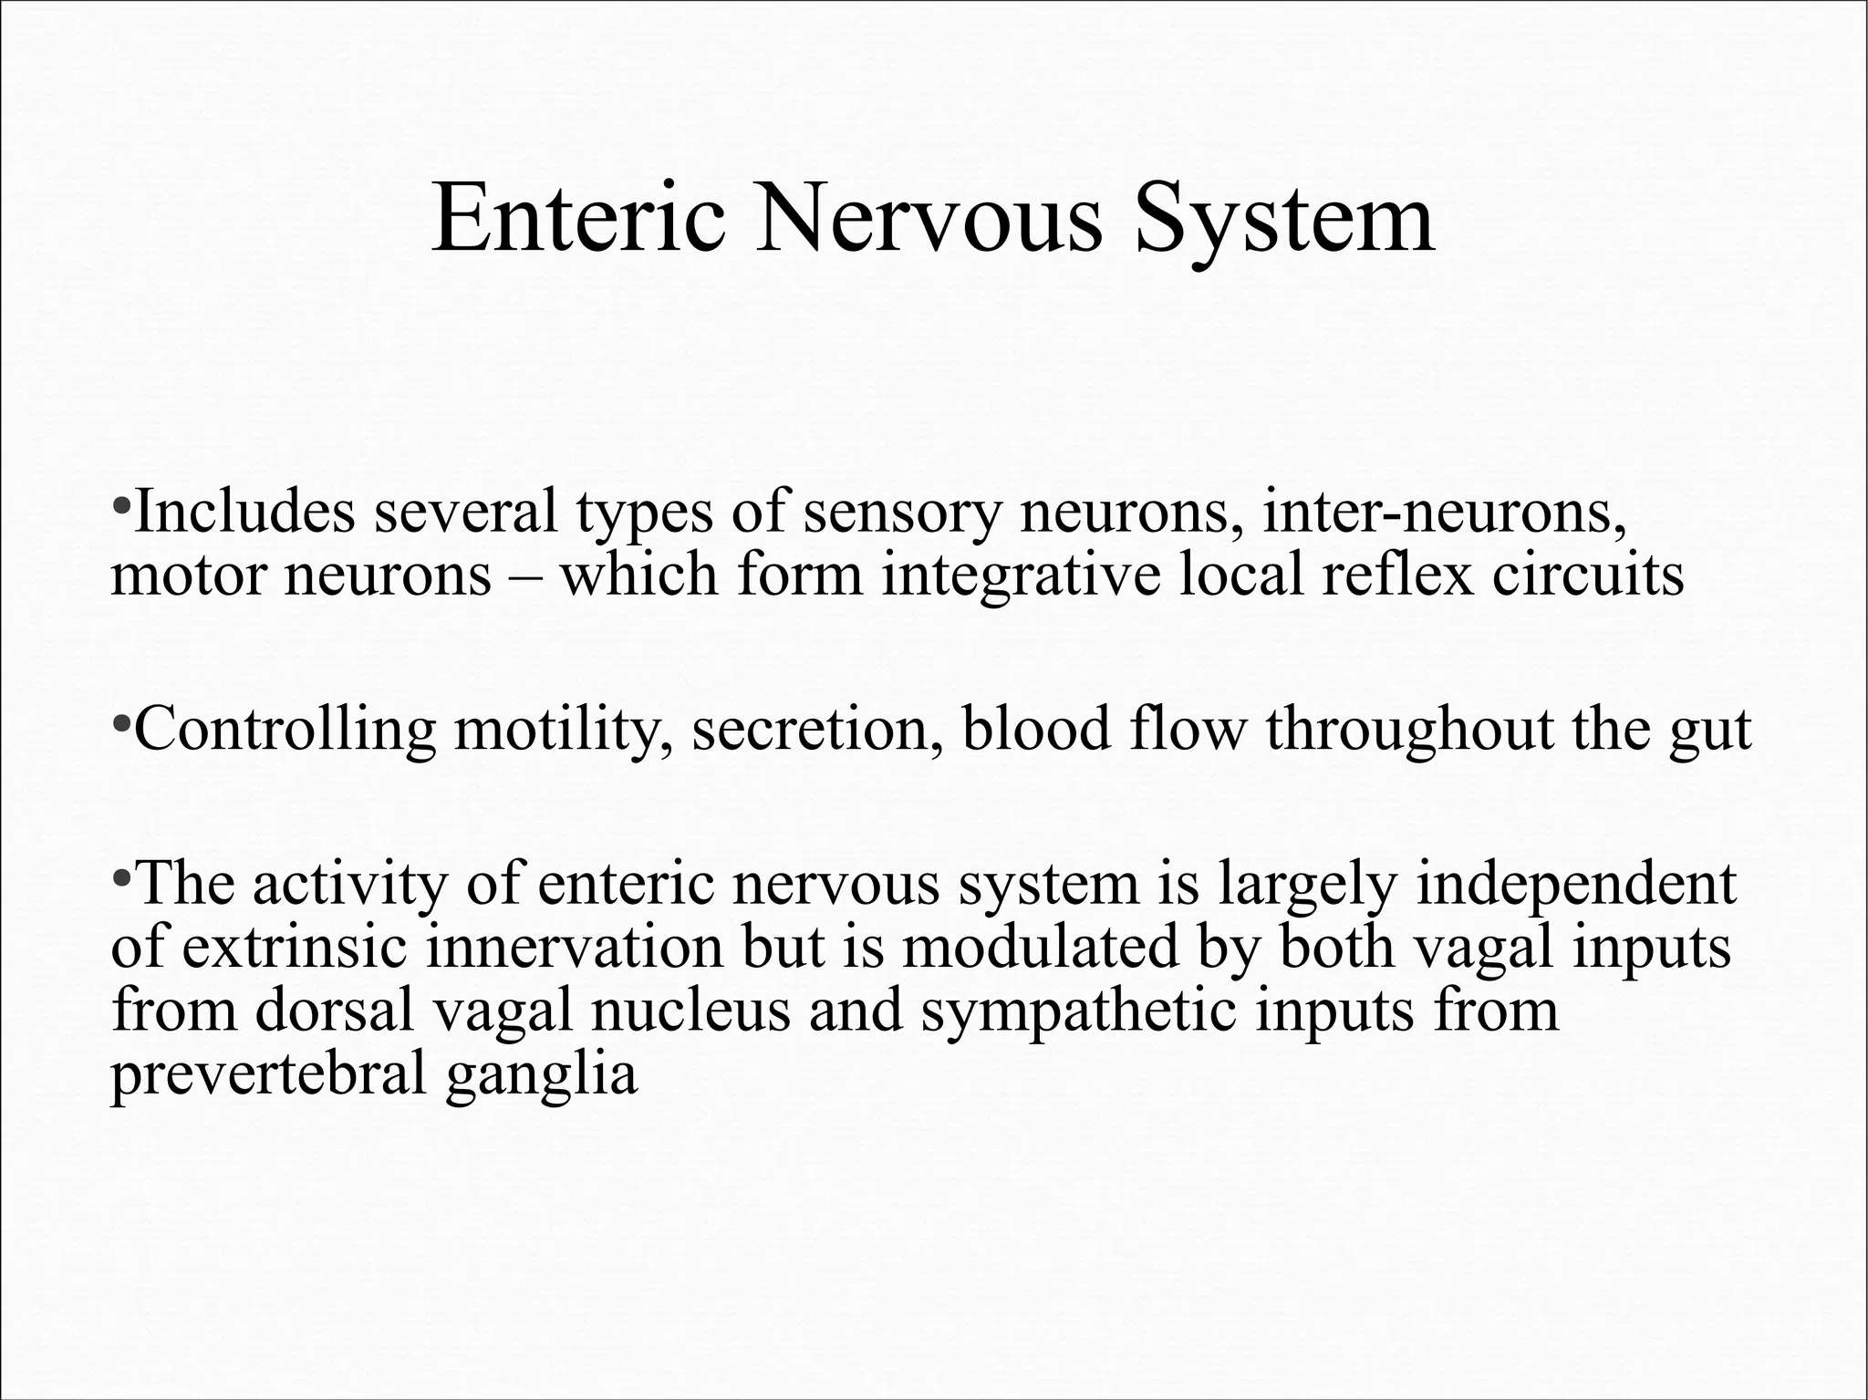

Slide 53
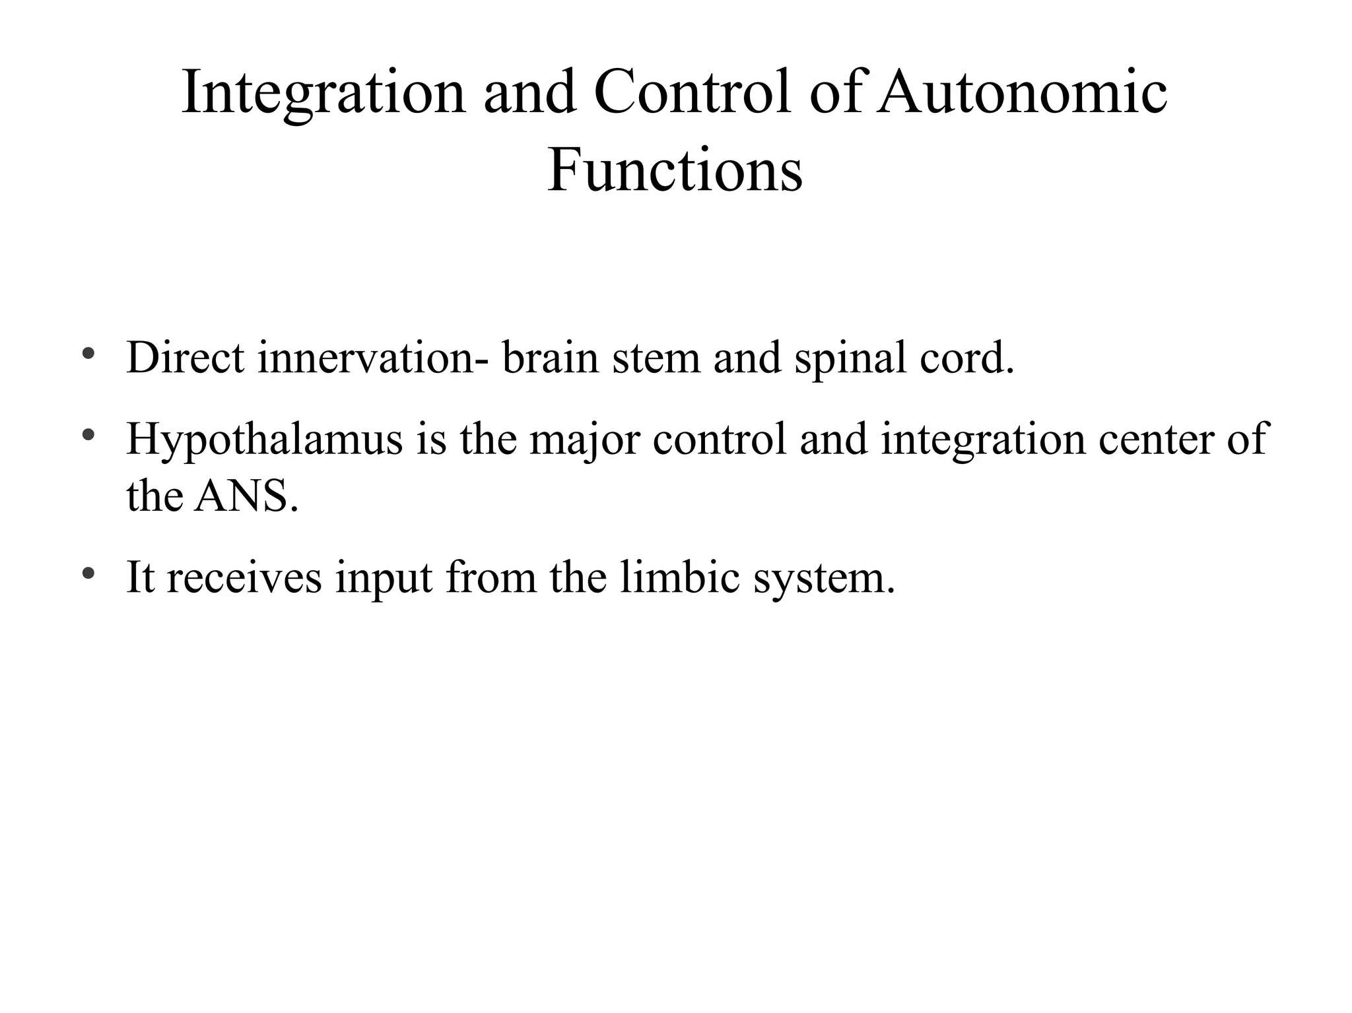

Slide 54
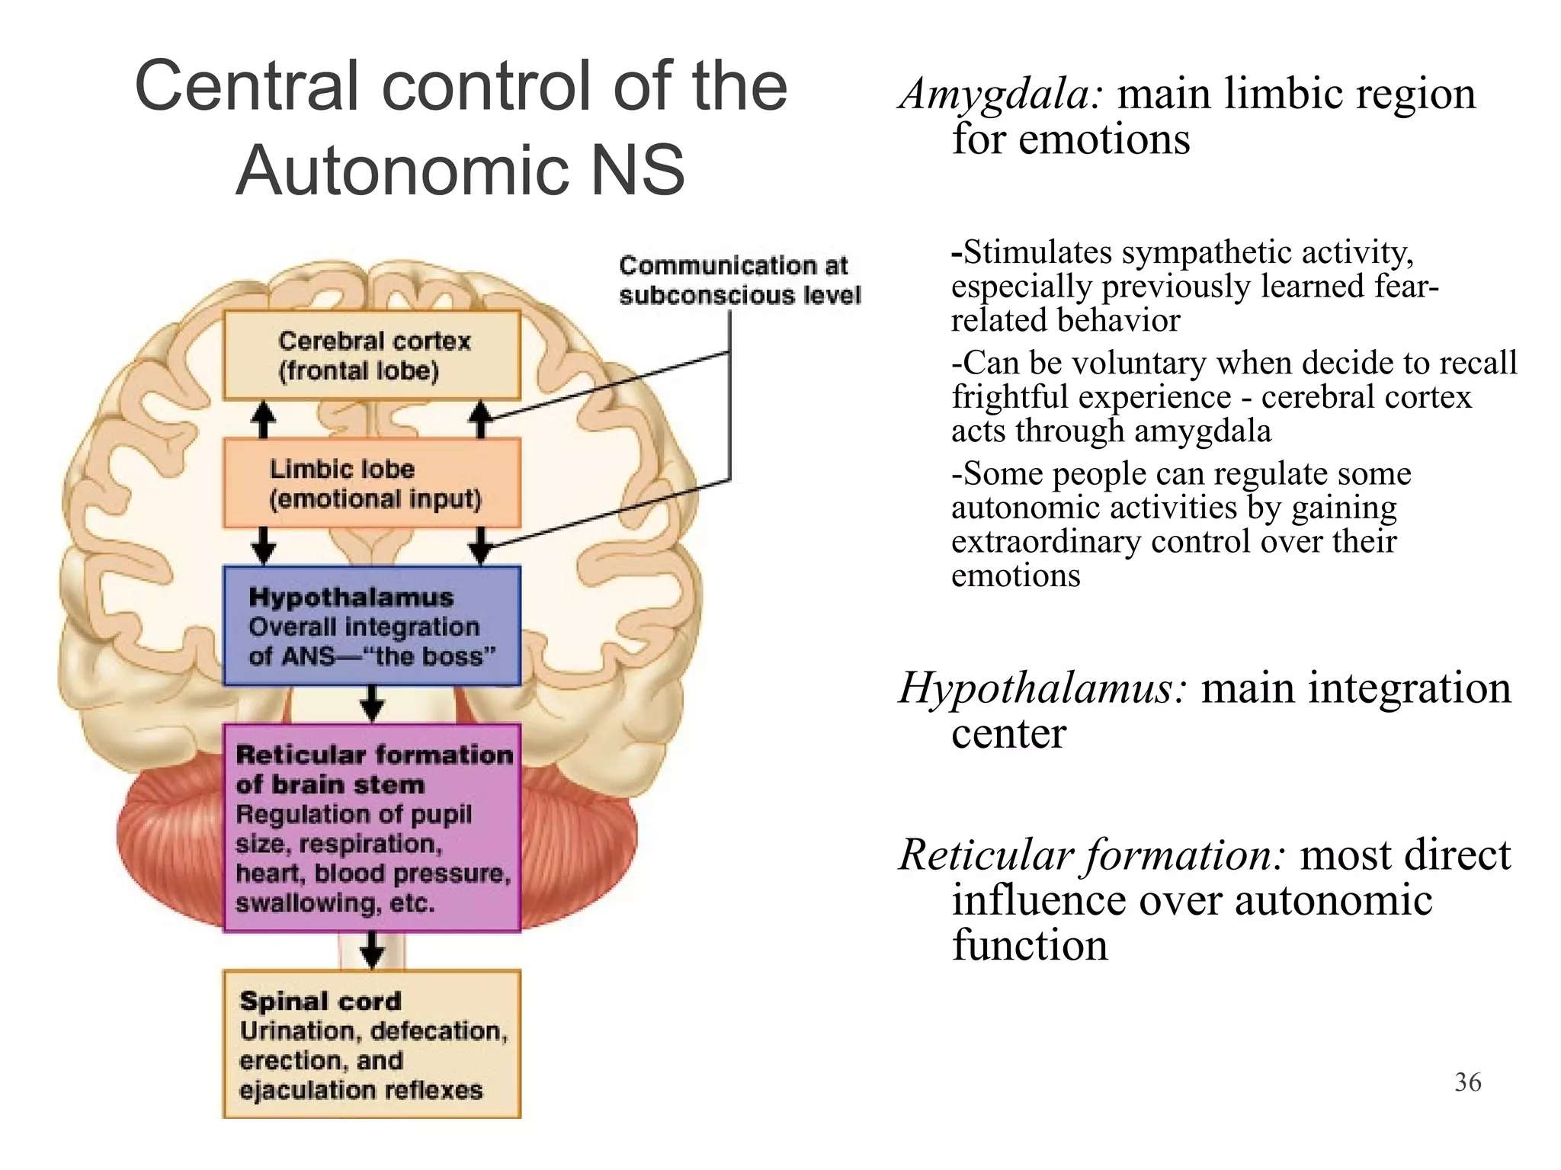

Slide 55
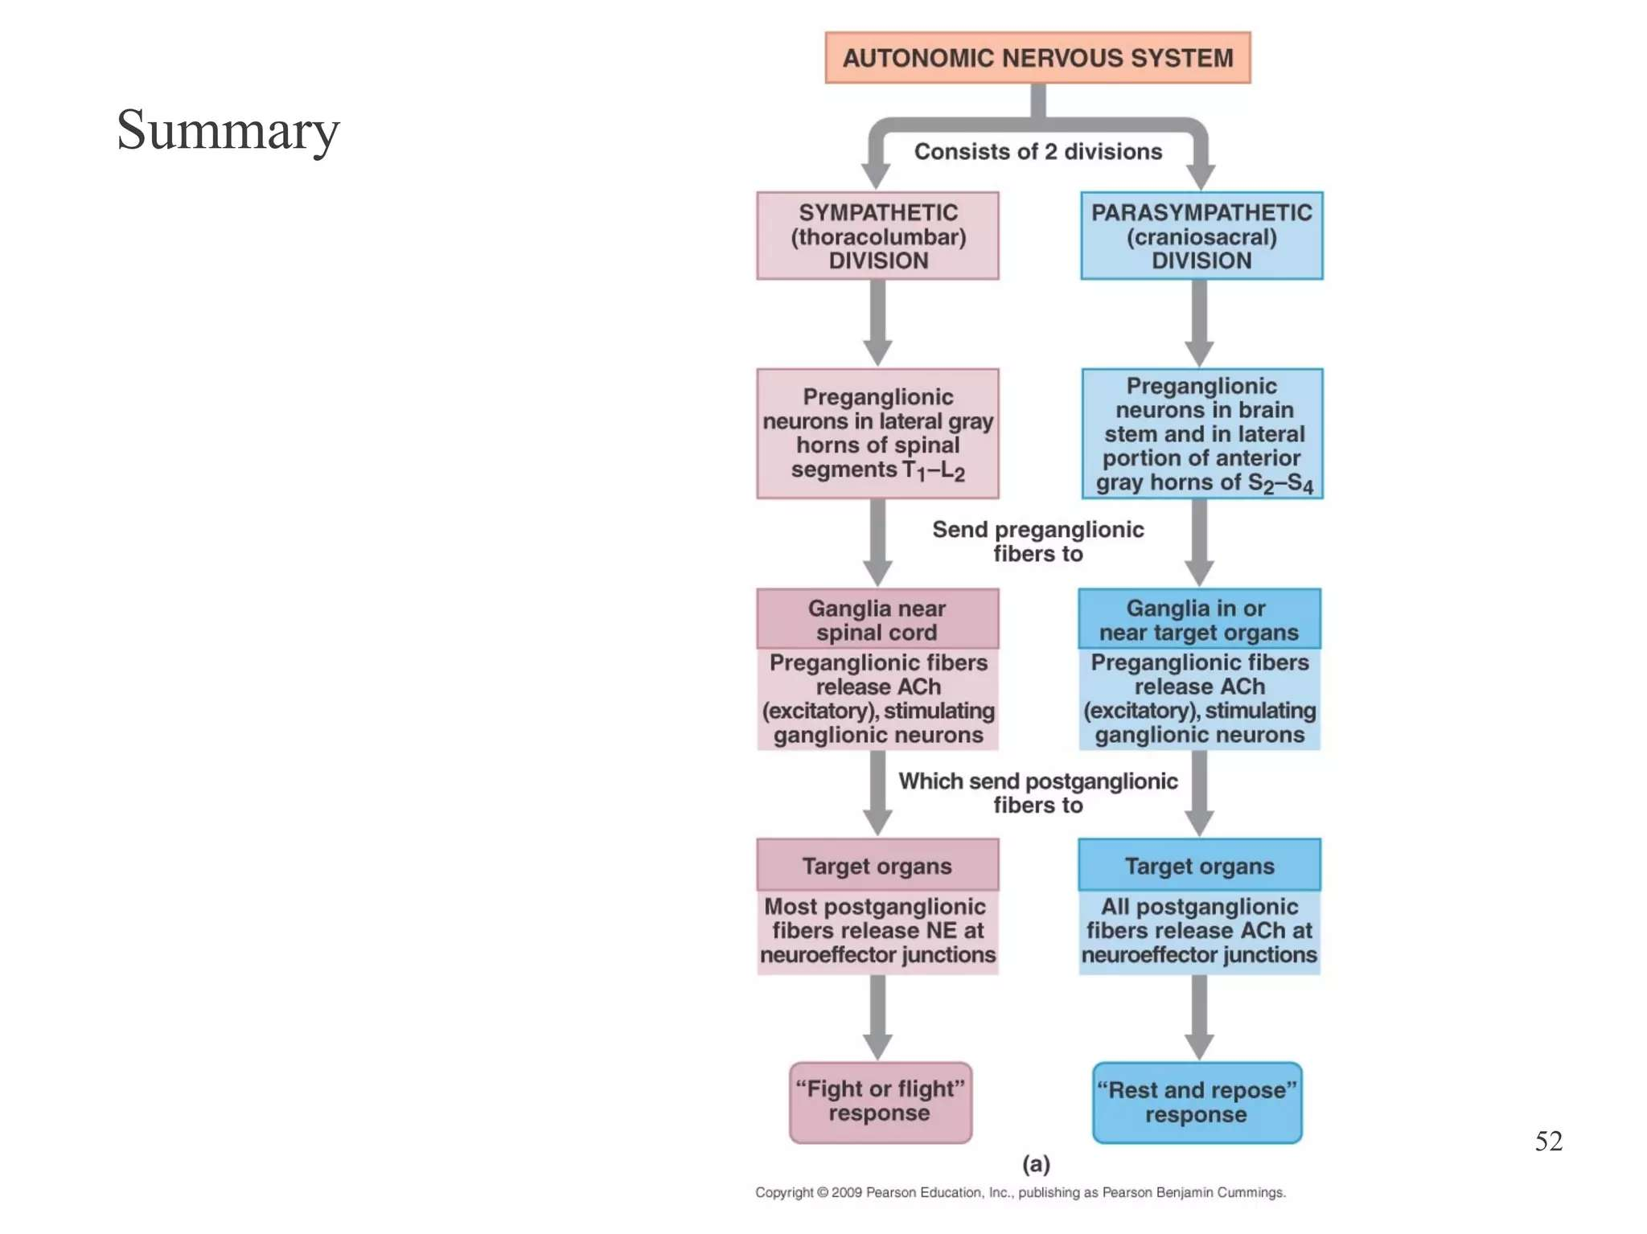

Slide 56
THANKS

